Slide 1
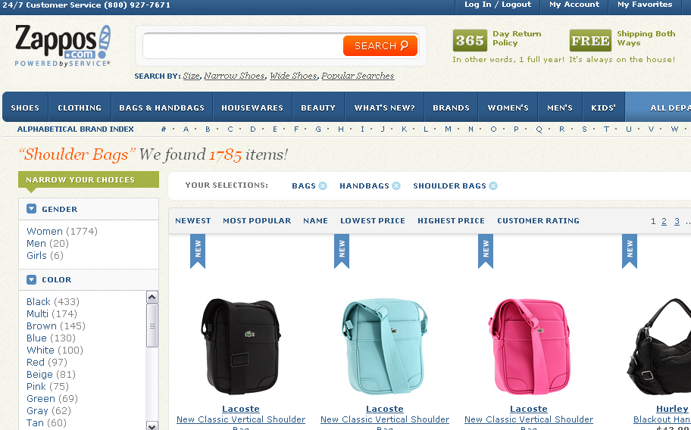

Chapter 2
Overview of Electronic Commerce

Slide 2
LEARNING OBJECTIVES
Define electronic commerce (EC) and describe its various categories.
Describe framework of EC.
Describe the major types of EC transactions.
Understand the elements of the digital world(pure and partial)

Slide 3
LEARNING OBJECTIVES
Describe the drivers of EC as they relate to business pressures and organizational responses.
Describe some EC business models.
Describe the benefits and limitations of EC to organizations, consumers, and society.

Slide 4
ELECTRONIC COMMERCE :
DEFINITIONS AND CONCEPTS
EC
VS
EB
electronic commerce (EC)
The process of buying, selling, or exchanging products, services, or information via computer network.
e-business
A broader definition of EC that includes not just the buying and selling of goods and services, but also servicing customers, collaborating with business partners, and conducting electronic transactions within an organization.

Slide 5
MAJOR EC CONCEPTS
  Pure Versus Partial EC
  EC can take several forms depending on the degree of digitization (the transformation from physical to digital) of:
    the product (service) sold
    the process (e.g., ordering, payment, fulfillment)
    the delivery method

Slide 6
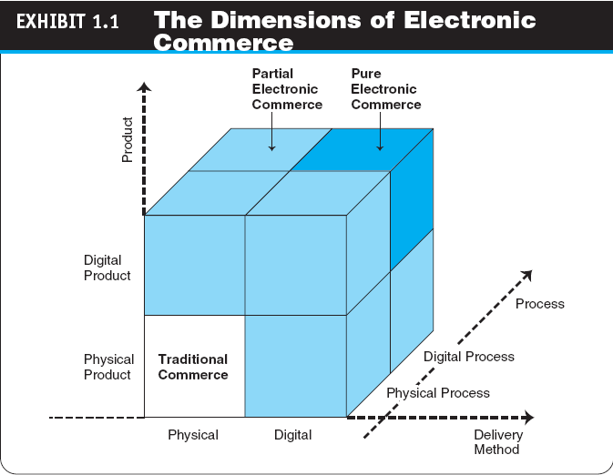
Ec dimensions

Slide 7
EC Organizations
    brick-and-mortar (old economy) organizations
    click-and-mortar (click-and-brick) organizations
    virtual (pure-play) organizations

Slide 8
  EC Organizations
MAJOR EC CONCEPTS
  EC Organizations
    brick-and-mortar (old economy) organizations
    Old-economy organizations (corporations) that perform their primary business offline, selling physical products by means of physical agents.

Slide 9
  EC Organizations
    virtual (pure-play) organizations
    Organizations that conduct their business activities solely online.
    click-and-mortar (click-and-brick) organizations
    Organizations that conduct some e-commerce activities, usually as an additional marketing channel.

Slide 10
Electronic Commerce:
Definitions and Concepts
  Interorganizational information systems (IOSs)
  Communications systems that allow routine transaction processing and information flow between two or more organizations
  Intraorganizational information systems
  Communication systems that enable e-commerce activities to go on within individual organizations

Slide 11
ELECTRONIC MARKETS AND NETWORKS
  electronic market (e-marketplace)
  An online marketplace where buyers and sellers meet to exchange goods, services, money, or information.
  intranet
  An internal corporate or government network that uses Internet tools, such as Web browsers, and Internet protocols.
  extranet
  A network that uses the Internet to link multiple intranets.

Slide 12
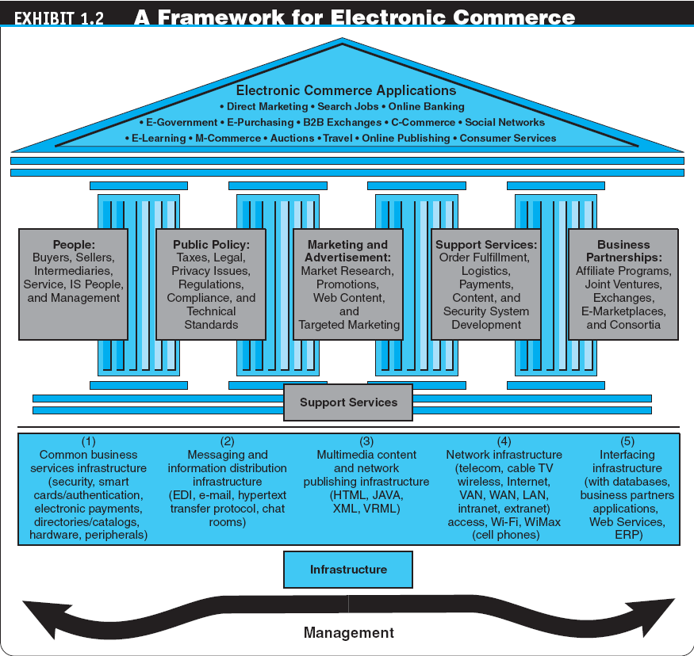

Slide 13
CLASSIFICATION OF EC BY THE NATURE OF THE TRANSACTIONS AND THE RELATIONSHIPS AMONG PARTICIPANTS
  business-to-business (B2B)
  E-commerce model in which all of the participants are businesses or other organizations.
  business-to-consumer (B2C)
  E-commerce model in which businesses sell to individual shoppers.

Slide 14
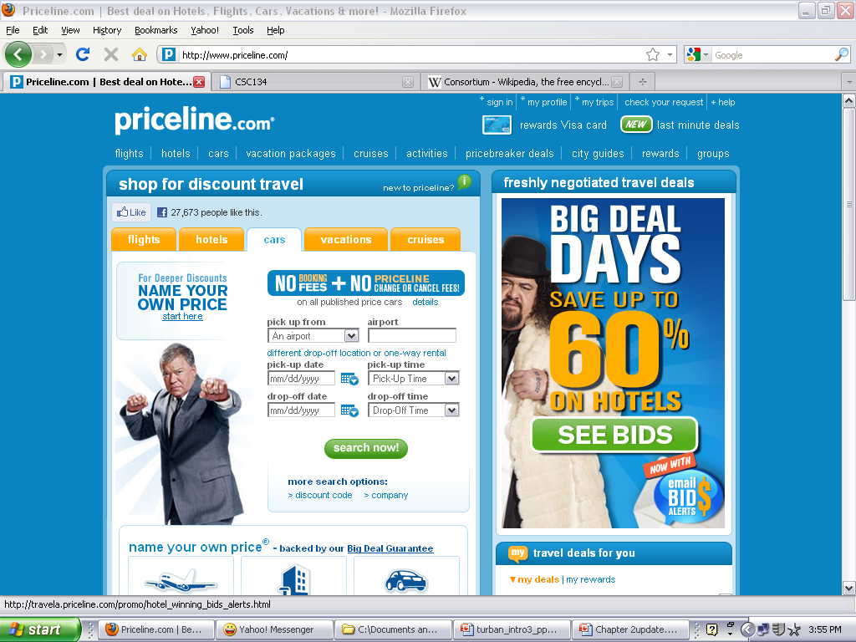
CLASSIFICATION OF EC BY THE NATURE OF THE TRANSACTIONS AND THE RELATIONSHIPS AMONG PARTICIPANTS
  e-tailing
  Online retailing, usually B2C.
  business-to-business-to-consumer (B2B2C)
  E-commerce model in which a business provides some product or service to a client business that maintains its own customers.
  consumer-to-business (C2B)
  E-commerce model in which individuals use the Internet to sell products or services to organizations or individuals who seek sellers to bid on products or services they need.eg : priceline.com; organizer of C2B travel service transactions

Slide 15
  intrabusiness EC
  E-commerce category that includes all internal organizational activities that involve the exchange of goods, services, or information among various units and individuals in an organization.
  business-to-employees (B2E)
  E-commerce model in which an organization delivers services, information, or products to its individual employees.
  consumer-to-consumer (C2C)
  E-commerce model in which consumers sell directly to other consumers.

Slide 16
  collaborative commerce (c-commerce)
  E-commerce model in which individuals or groups communicate or collaborate online.
  e-learning
  The online delivery of information for purposes of training or education.
  e-government
  E-commerce model in which a government entity buys or provides goods, services, or information from or to businesses or individual citizens.

Slide 17
E-COMMERCE 2.0: FROM WEB 2.0 TO ENTERPRISE SOCIAL NETWORKING AND VIRTUAL WORLDS
SOCIAL COMPUTING
An approach aimed at making the human–computer interface more natural.
social network
A category of Internet applications that help connect friends, business partners, or individuals with specific interests by providing free services such as photos presentation, e-mail, blogging, and so on using a variety of tools.
Web 2.0
The second generation of Internet-based services that lets people collaborate and share information online in new ways, such as social networking sites, wikis, communication tools, and folksonomies.

Slide 18
E-COMMERCE 2.0: FROM WEB 2.0 TO ENTERPRISE SOCIAL NETWORKING AND VIRTUAL WORLDS
social network service (SNS)
A service that builds online communities by providing an online space for people to build free homepages and that provides basic communication and support tools for conducting different activities in the social network.
  social networking
  The creation or sponsoring of a social network service and any activity, such as blogging, done in a social network (external or internal).

Slide 19
E-COMMERCE 2.0: FROM WEB 2.0 TO ENTERPRISE SOCIAL NETWORKING AND VIRTUAL WORLDS
business-oriented networks
Social networks whose primary objective is to facilitate business.
  Example of a Business-Oriented Social Network: Xing.com
ENTERPRISE SOCIAL NETWORKS
  Example of an Enterprise Social Network: Carnivalconnections.com

Slide 20
THE DIGITAL WORLD:
ECONOMY, ENTERPRISES, AND SOCIETY
digital economy
An economy that is based on digital technologies, including digital communication networks, computers, software, and other related information technologies; also called the Internet economy, the New economy, or the Web economy.

Slide 21
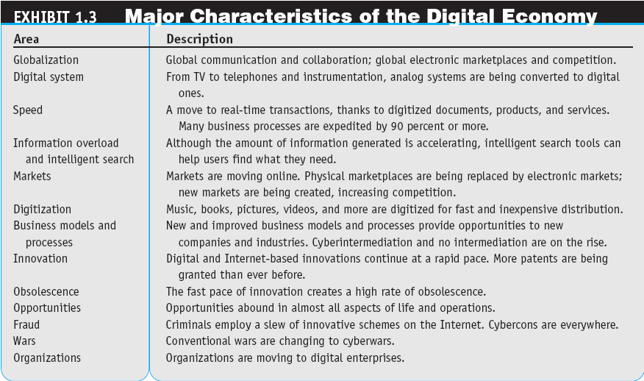

Slide 22
THE DIGITAL WORLD:
ECONOMY, ENTERPRISES, AND SOCIETY
digital enterprise
A new business model that uses IT in a fundamental way to accomplish one or more of three basic objectives: reach and engage customers more effectively, boost employee productivity, and improve operating efficiency. It uses converged communication and computing technology in a way that improves business processes.
  corporate portal
  A major gateway through which employees, business partners, and the public can enter a corporate Web site.
THE DIGITAL SOCIETY
  The final, and perhaps most important, element of the digital world is people and the way they live and interact.

Slide 23
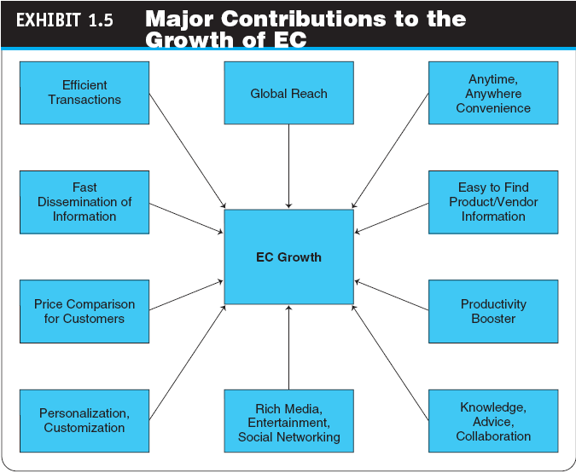

Slide 24
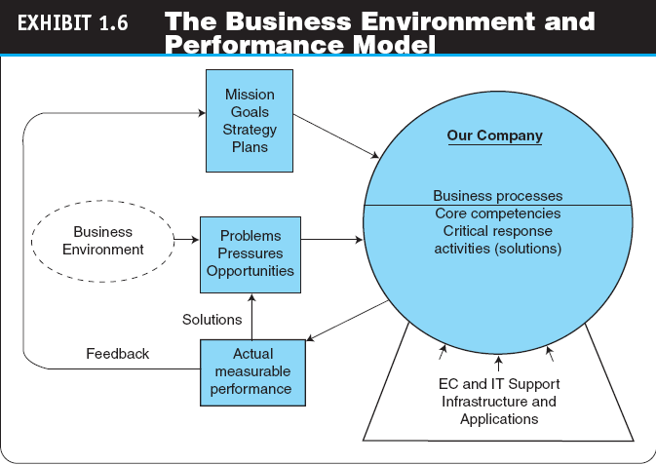

Slide 25
ELECTRONIC COMMERCE BUSINESS MODELS
business model
A method of doing business by which a company can generate revenue to sustain itself.
  value proposition
  The benefits a company can derive from using EC.
THE STRUCTURE AND PROPERTIES OF BUSINESS MODELS
  Revenue Models
    Sales
    Transaction Fees
    Subscription Fees
    Advertising Fees
    Affiliate Fees

Slide 26
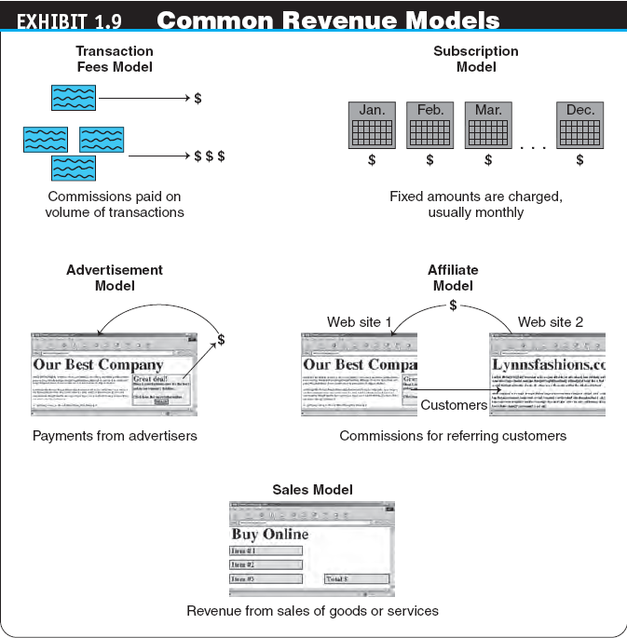

Slide 27
  Functions of a Business Model
    Describe the major business processes of a company
    Identify a market segment
    Define the venture’s specific value chain structure
    Estimate the cost structure and profit potential

Slide 28
TYPICAL EC BUSINESS MODELS
  Online direct marketing
  Electronic tendering systems
    tendering (bidding) system
    Model in which a buyer requests would-be sellers to submit bids; the lowest bidder wins.
  Electronic marketplaces and exchanges
  Viral marketing
  Social networking and Web 2.0 tools

Slide 29
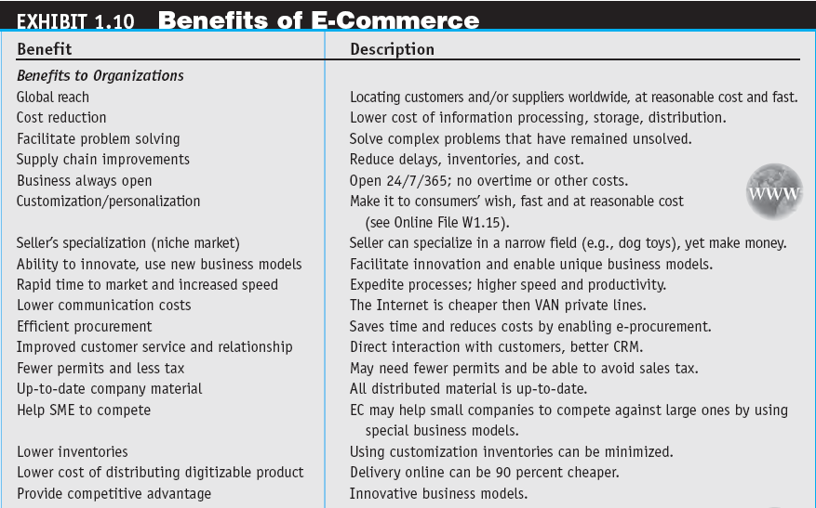

Slide 30
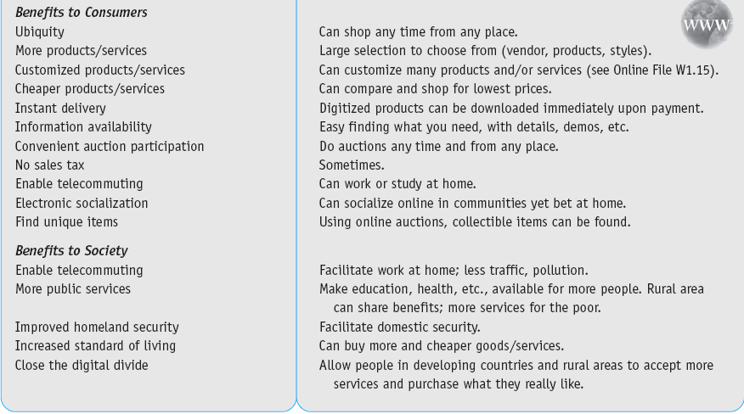

Slide 31
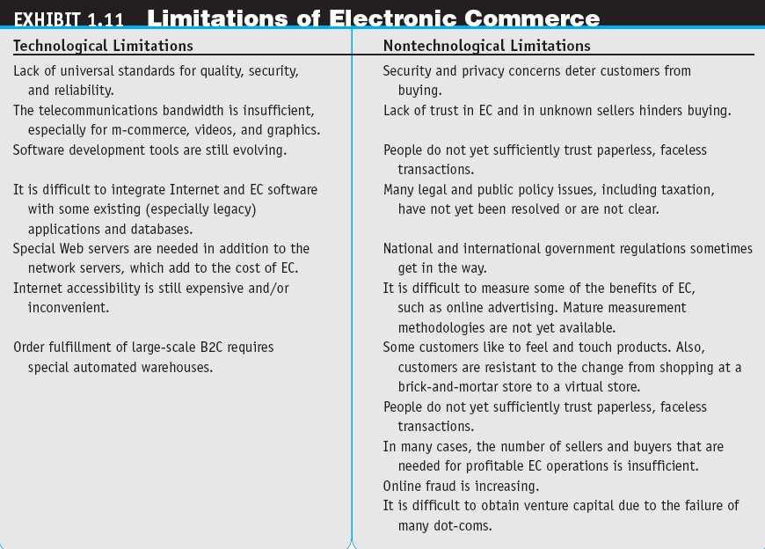

Slide 32
BENEFITS, LIMITATIONS, AND IMPACTS
OF ELECTRONIC COMMERCE
Ethical Issues
  ethics
  The branch of philosophy that deals with what is considered to be right and wrong.
WHY STUDY E-COMMERCE?

Slide 33
Summary
E-commerce and E-Business
EC Concepts and EC Dimensions
EC Organizations
EC market and networks
Classification of EC
Framework EC
Revenue Models
Benefits and limitations of EC

