Slide 1
Chapter 4
E-Commerce :
Products and Services

Slide 2
Topic:
a. E-tailing and the B2C markets b. Virtual Travel Agency, Employment placement and Online banking c. Problems and issues

Slide 3
Learning Objectives
Describe electronic retailing (e-tailing) and its characteristics.
Define and describe the primary
e-tailing business models.
Describe how online travel and tourism services operate and their impact on the industry.
Discuss the online employment market, including its participants, benefits, and limitations.
Describe online real estate services.
Discuss online stock-trading services.

Slide 4
Learning Objectives
Discuss cyberbanking and online personal finance.
Describe on-demand delivery of groceries and similar products/services.
Describe the delivery of digital products and online entertainment.
Discuss various online consumer aids, including comparison-shopping aids.
Describe disintermediation and other B2C strategic issues.

Slide 5
INTERNET MARKETING
AND ELECTRONIC RETAILING
electronic retailing (e-tailing)
Retailing conducted online, over the Internet.
e-tailers
Retailers who sell over the Internet.
e-tailing conduct catalogs –easier for a manufacture to sell directly and cut cost for intermediary
Retailers: sales intermediary , operates between manufactures and customers

Slide 6
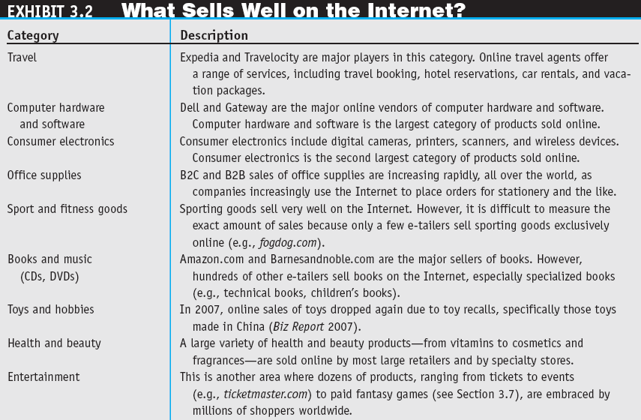

Slide 7
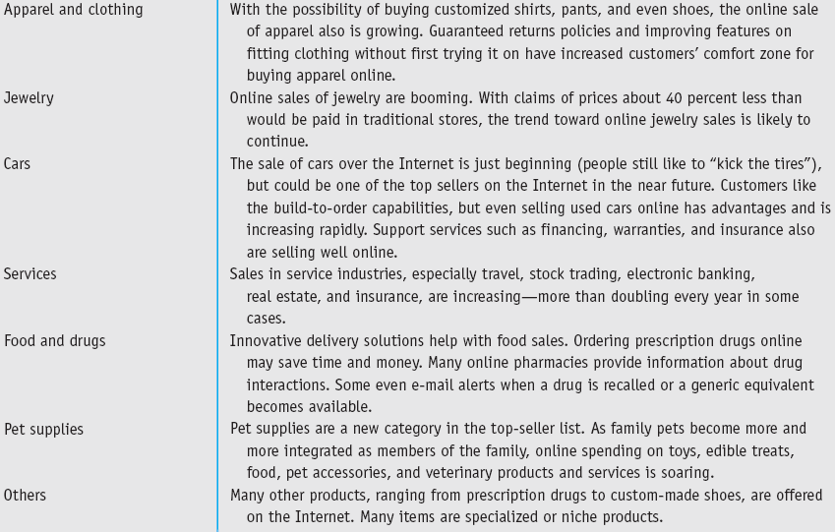

Slide 8
INTERNET MARKETING
AND ELECTRONIC RETAILING
considered commerce
Conducting e-commerce where the online channel of a business is integrated with the physical retail business as opposed to being a separate channel.

Slide 9
INTERNET MARKETING
AND ELECTRONIC RETAILING
CHARACTERISTICS AND ADVANTAGES OF SUCCESSFUL E-TAILING
  Sound business thinking, visionary leadership, thorough competitive analysis and financial analysis, and the articulation of a well-thought-out EC strategy are essential.
  Ensure appropriate infrastructure, particularly a stable and scalable technology infrastructure to support the online and physical aspects of EC business operations.
  Page 136 (Retailing versus E-Tailing)

Slide 10
E-TAILING BUSINESS MODELS
CLASSIFICATION OF MODELS BY DISTRIBUTION CHANNEL
  Direct marketing by mail-order retailers that go online
  Direct marketing by manufacturers
  Pure-play e-tailers
  Click-and-mortar retailers
  Internet (online) malls

Slide 11
E-TAILING BUSINESS MODELS
  Direct marketing
  Broadly, marketing that takes place without intermediaries between manufacturers and buyers; takes order directly from customer using e-mail.Their main distribution channel is direct marketing . Eg: http://www.sharperimage.com/
  Direct Sales by Manufacturers
  Directly from company to individual customer. Customer gain info.
  Eg: Sony,Dell. Eg: http://www.sony.com.my/section/home
  Virtual (pure-play) e-tailers
  E-tailers do not have physical stores, only online sales.
  Eg: www.amazon.com

Slide 12
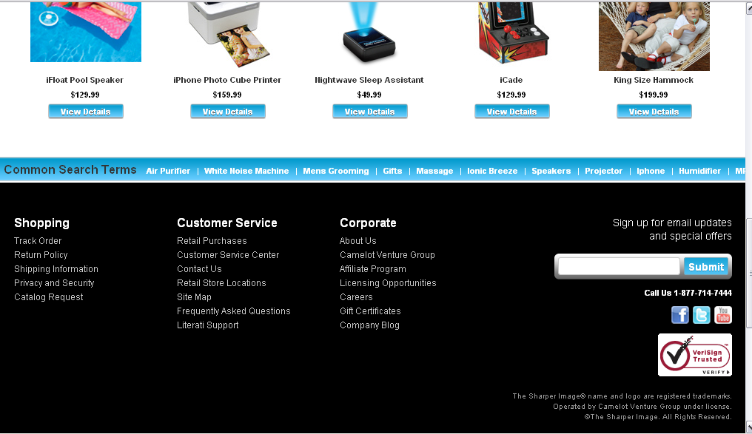
Direct marketing by mail orders

Slide 13
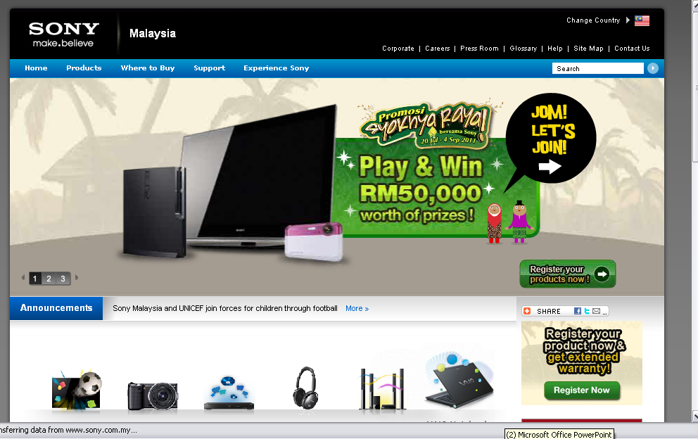
Direct marketing by Manufactures

Slide 14
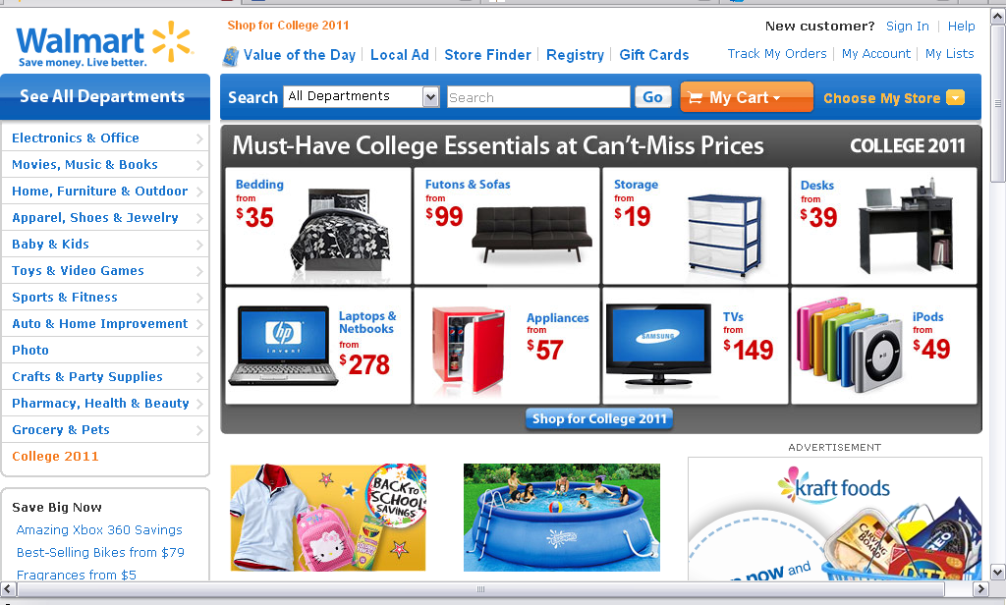
Click mortar retailers

Slide 15
E-TAILING BUSINESS MODELS
  click-and-mortar retailers
  Brick-and-mortar retailers that offer a transactional Web site from which to conduct business.
  multichannel business model
  A business model where a company sells in multiple marketing channels simultaneously (e.g., both physical and online stores).eg: wallmart: http://www.walmart.com/

Slide 16
E-TAILING BUSINESS MODELS
  Retailing in Online Malls
    Referring Directories (affiliate)
    Malls with Shared Services
OTHER B2C MODELS AND SPECIAL RETAILING
  Online Group Buying (buying in bulk to get lower prices)
B2C IN SOCIAL NETWORKS
  Virtual Shopping

Slide 17
TRAVEL AND TOURISM (HOSPITALITY) SERVICES ONLINE
SERVICES PROVIDED
SPECIAL SERVICES ONLINE
  Wireless services
  Direct marketing
  Alliances and consortia
  Travel-Oriented Social Networks

Slide 18
TRAVEL AND TOURISM (HOSPITALITY) SERVICES ONLINE
BENEFITS OF ONLINE TRAVEL SERVICES
  Free information
  Accessible at any time from any place
  Substantial discounts
LIMITATIONS OF ONLINE TRAVEL SERVICES
  Many people do not use the Internet
  The amount of time and the difficulty of using virtual travel agencies can be significant
  Complex trips or those that require stopovers might not be available online
CORPORATE TRAVEL

Slide 19
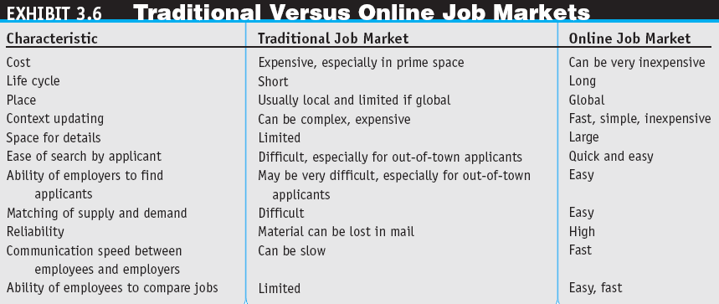

Slide 20
EMPLOYMENT PLACEMENT
AND THE JOB MARKET ONLINE
Theses parties use the Internet job market:
  Job seekers
  Employers seeking employees
  Classified ads
  Job agencies
  Government agencies and institutions
  Online Job Markets on Social Networking
  Global Online Portals

Slide 21
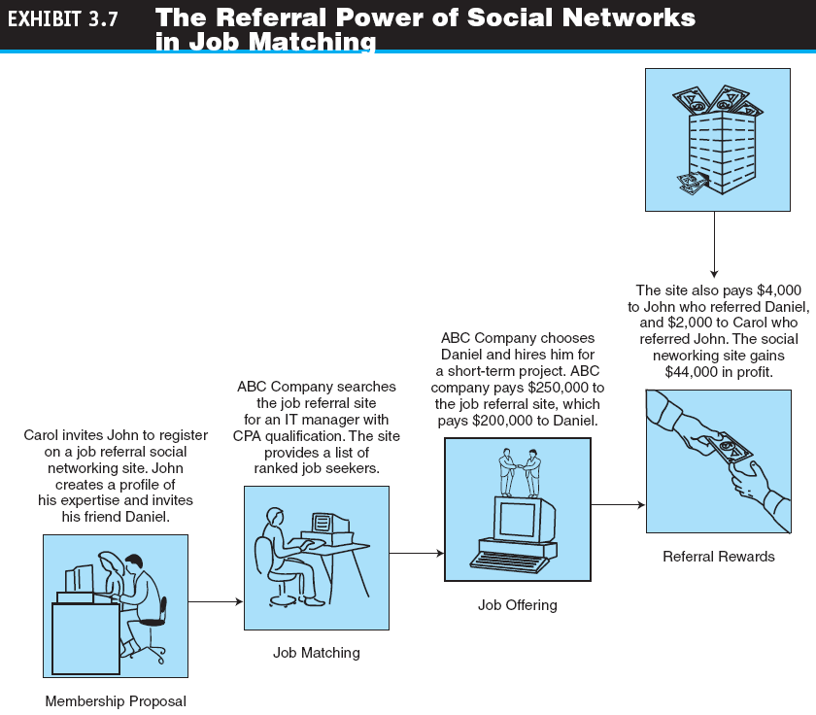

Slide 22
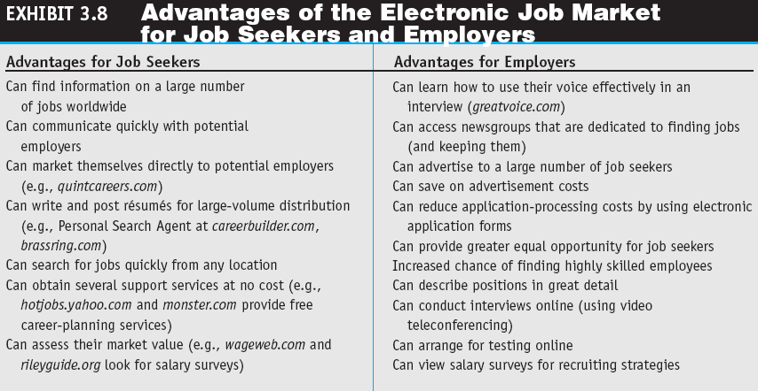

Slide 23
REAL ESTATE, INSURANCE,
AND STOCK TRADING ONLINE
REAL ESTATE ONLINE
  Eg: Zillow, Craigslist, and Other Web 2.0 Real Estate Services.
INSURANCE ONLINE
ONLINE STOCK TRADING (benefits)
No busy telephone lines
Chance error small, because no oral communication.
Order any place , anytime
No biased broker to push sale.
Investor find a considerable amount of free research info.
  The Risk of Trading in an Online Stock Account- Security (ID & password) can have steal problem.

Slide 24
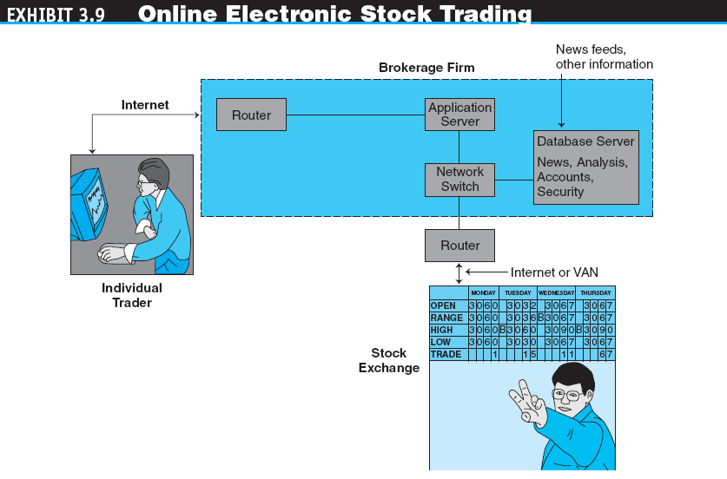

Slide 25
BANKING AND
PERSONAL FINANCE ONLINE
electronic (online) banking or
e-banking/cyberbanking/virtual banking/ home banking.
Various banking activities conducted from home or the road using an Internet connection

Slide 26
BANKING AND
PERSONAL FINANCE ONLINE
HOME BANKING CAPABILITIES (page 155): Quest May 2010
VIRTUAL BANKS- no physical location but only conduct online trancasction.eg: SFNB offer secure banking transaction on web. Mostly fail, more success when click mortar.
INTERNATIONAL AND MULTIPLE-CURRENCY BANKING.
-Some retail purchasing need international banking.eg when using the MasterCard can be anywhere. Eg: bank of America.

Slide 27
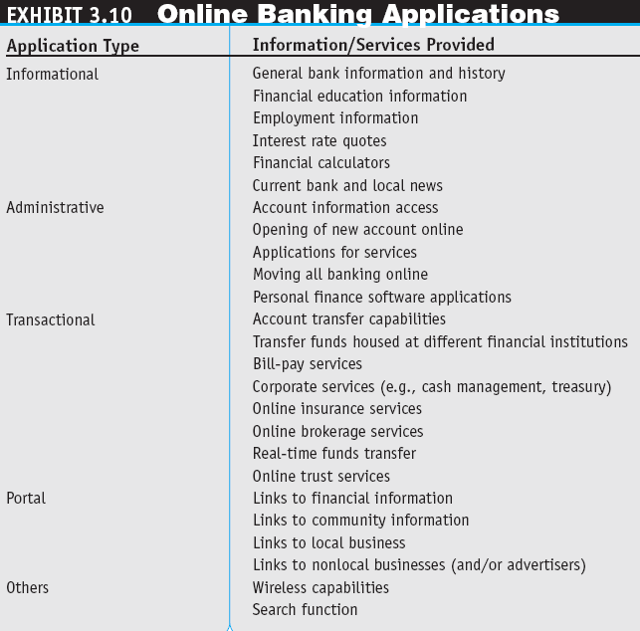

Slide 28
BANKING AND
PERSONAL FINANCE ONLINE
Online financial transaction: lower cost process, online more faster.
ONLINE FINANCIAL TRANSACTION IMPLEMENTATION ISSUES
  Securing Financial Transactions: Bank provides security & privacy to its customer.
  Imaging Systems: Several financial institutions allow us to view image invoicing checks and others doc
  Fees Online Versus Fees for Offline Services: Computer based, free services , some charges fees.
  Risks.: esp. international banking. Risk of hackers getting acct.
ONLINE BILLING AND BILL PAYING
  Taxes

Slide 29
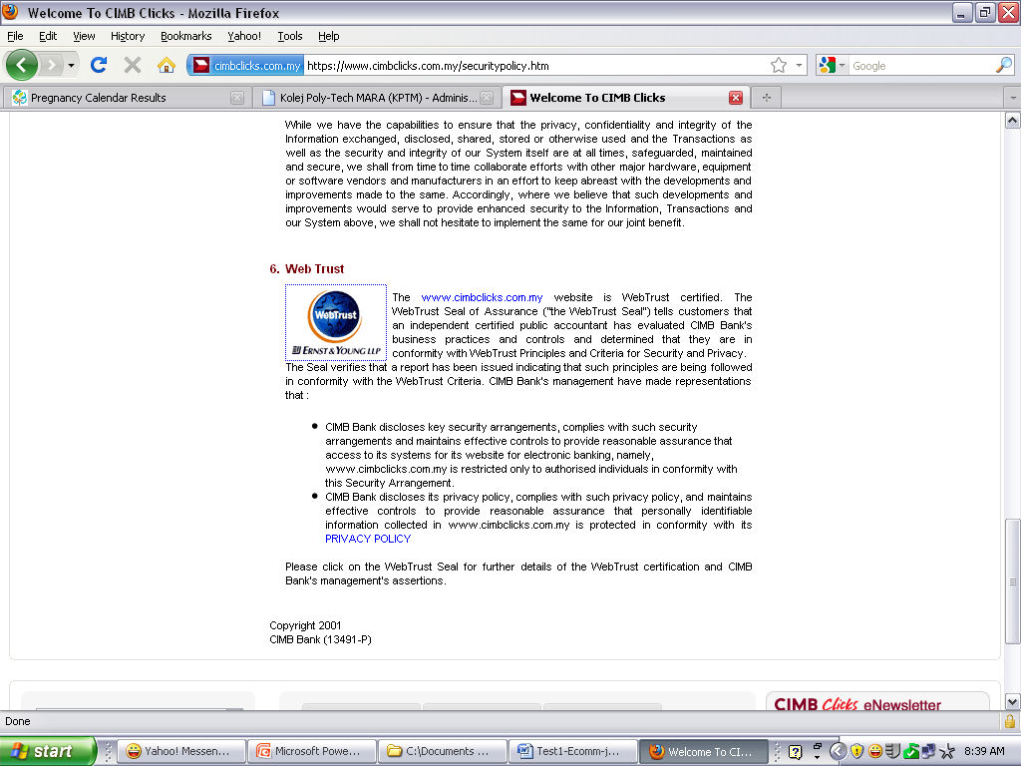

Slide 30
ON-DEMAND DELIVERY OF PRODUCTS,
DIGITAL ITEMS, ENTERTAINMENT, AND GAMING
ON-DEMAND DELIVERY OF PRODUCTS
  e-grocer
  A grocer that takes orders online and provides deliveries on a daily or other regular schedule or within a very short period of time.
  on-demand delivery service
  Express delivery made fairly quickly after an online order is received.

Slide 31
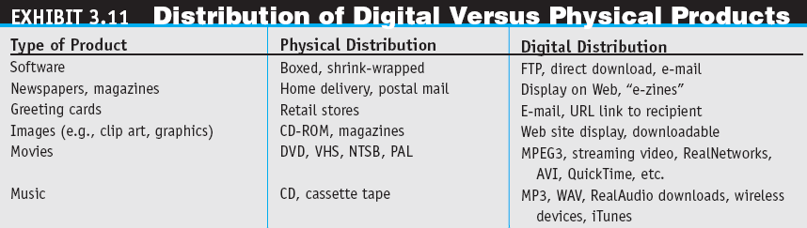

Slide 32
ON-DEMAND DELIVERY OF PRODUCTS,
DIGITAL ITEMS, ENTERTAINMENT, AND GAMING
ONLINE ENTERTAINMENT
  Adult Entertainment
  Internet Gaming
  Online Dating Services

Slide 33
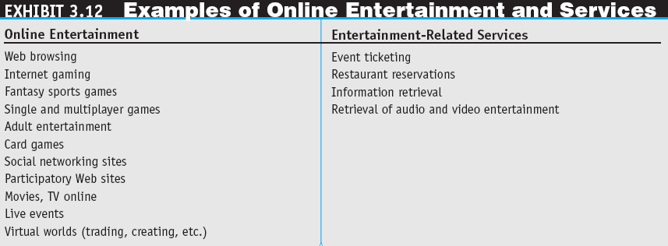

Slide 34
ONLINE PURCHASE-DECISION AIDS
shopping portals
Gateways to e-storefronts and
e-malls; may be comprehensive or niche oriented.

Slide 35
ONLINE PURCHASE-DECISION AIDS
shopping robots (shopping agents or shopbots)
Tools that scout the Web on behalf of consumers who specify search criteria.
  ''Spy'' Services:
  Notify the finding
  Monitor new info , special sales
  Stock updates ending time of auction
  Sending email for special sales.
  Wireless Shopping Comparisons (using cell phones , anytime & anywhere enable to compare prices

Slide 36
ONLINE PURCHASE-DECISION AIDS
BUSINESS RATINGS SITES
TRUST VERIFICATION SITE
    To remember the key issues of trust in electronic payments ,the acronyms TRUSTe.com
  Recommendations from Other Shoppers and Friends
    referral economy
    The effect upon sales of consumers receiving a referral or recommendation from other consumers.
OTHER SHOPPING TOOLS

Slide 37
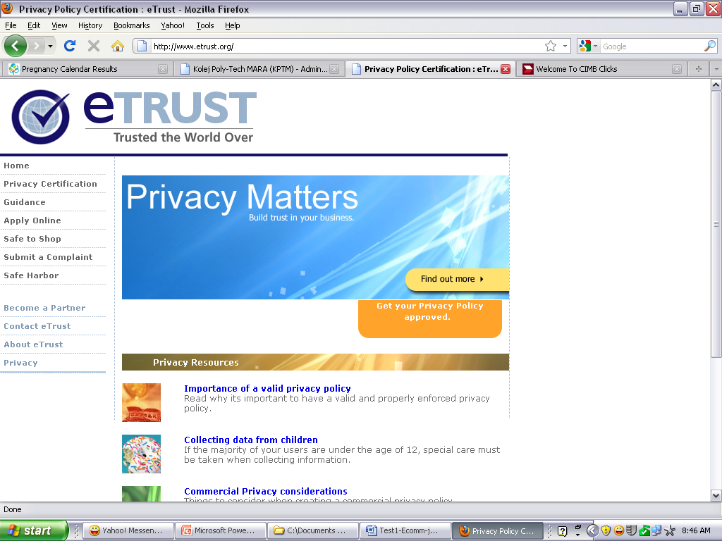

Slide 38
ISSUES IN E-TAILING
AND LESSONS LEARNED
disintermediation
The removal of organizations or business process layers responsible for certain intermediary steps in a given supply chain.
reintermediation
The process whereby intermediaries (either new ones or those that had been disintermediated) take on new intermediary roles.

Slide 39
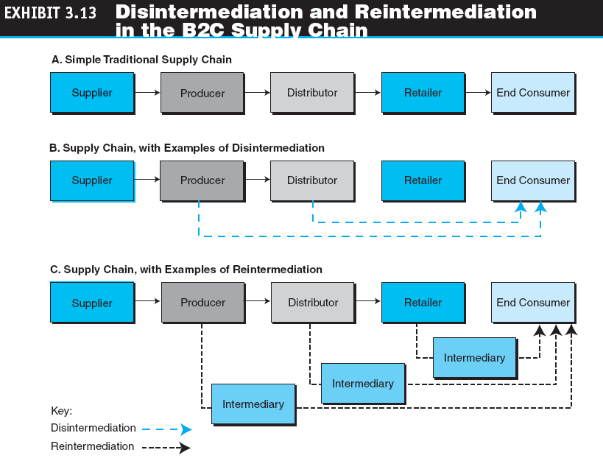

Slide 40
ISSUES IN E-TAILING
AND LESSONS LEARNED
channel conflict
Situation in which an online marketing channel upsets the traditional channels due to real or perceived damage from competition.
DETERMINING THE RIGHT PRICE
PRODUCT AND SERVICE CUSTOMIZATION AND PERSONALIZATION
FRAUD AND OTHER ILLEGAL ACTIVITIES

Slide 41
ISSUES IN E-TAILING
AND LESSONS LEARNED
LESSONS LEARNED FROM FAILURES AND LACK OF SUCCESS
  Speak with one voice
  Leverage the multi-channels
  Empower the customer

Slide 42
Revision
1. List 5 e-tailing models
2. Three services online of travel and tourism
3. Who are the parties use the internet job market?
4. What is viral marketing?

Slide 43
Revision 2
1. Four revenue model
2. Five area support in framework e-commerce
3. Three functions of markets

Slide 44
MANAGERIAL ISSUES
What are the limitations of
e-tailing?
How should we introduce wireless shopping?
Do we have ethics and privacy guidelines?
How will intermediaries act in cyberspace?
Should we try to capitalize on social networks?

