Slide 1
E-Commerce Market Mechanisms
Chapter 3

Slide 2
Describe the major electronic commerce (EC) activities and processes and the mechanisms that support them.
Define e-marketplaces and list their components.
List the major types of e-marketplaces and describe their features.
Describe electronic catalogs, search engines, and shopping carts.
Describe the major types of auctions and list their characteristics.

Slide 3
Discuss the benefits, limitations, and impacts of auctions.
Describe bartering and negotiating online.
List the major Web 2.0 tools and their use in EC.
Understand virtual worlds and their use in EC.
Discuss competition in the digital economy.
Describe the impact of e-marketplaces on organizations, intermediation, and industries.

Slide 4
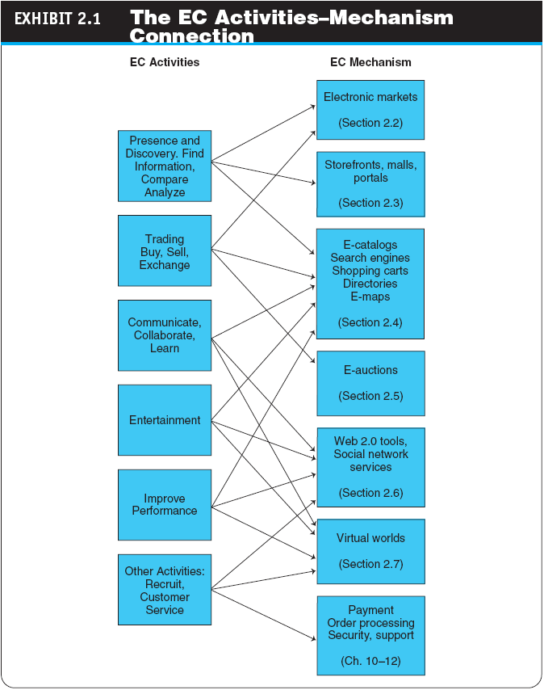

Slide 5
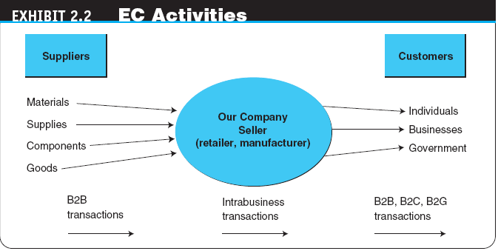

Slide 6
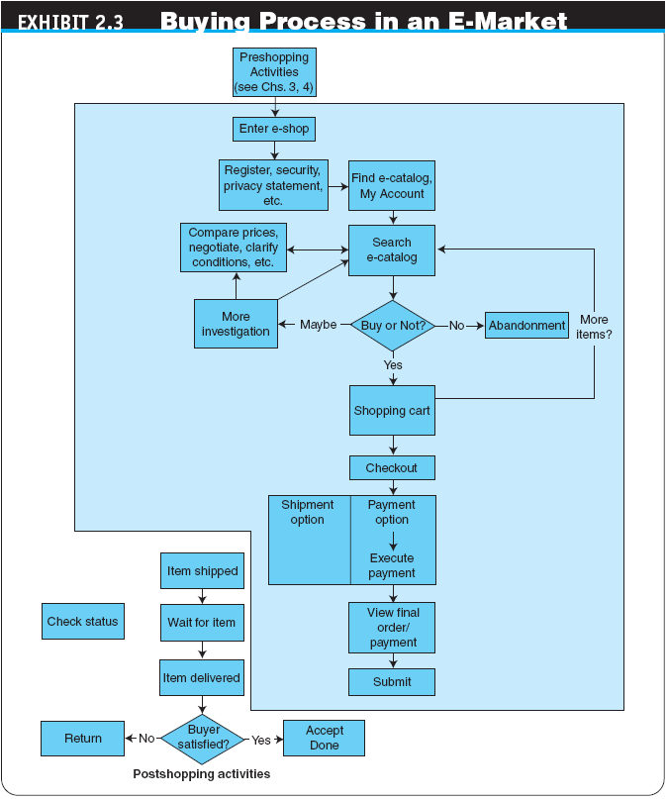

Slide 7
E-Marketplaces
e-marketplace
An online market, usually B2B, in which buyers and sellers exchange goods or services; the two types of e-marketplaces are private, and public.
marketspace
A marketplace in which sellers and buyers exchange goods and services for money (or for other goods and services).

Slide 8
3 functions e- marketplaces
1.Matching buyers and sellers
2. Facilitating the exchanges goods , services, payment with market functions
3. Providing institutional, infrastructure , legal. (pg.98)

Slide 9
E-marketplace Components
E-MARKETPLACE COMPONENTS AND PARTICIPANTS
1. Customers: who surf web for buy goods, bargain, collection items on internet
2. Sellers : sell direct from their web sites or marketplaces
3. Digital products & physical products
  Goods that can be transformed to digital format and delivered over the Internet
  4. Infrastructure :electronic hardware/software /network
  5. Front end
  The portion of an e-seller’s business processes through which customers interact, including the seller’s portal, electronic catalogs, a shopping cart, a search engine, and a payment gateway

Slide 10
E-marketplace Components
  Back end : The activities that support online order fulfillment, inventory management, purchasing from suppliers, payment processing, packaging, and delivery.
  Intermediary : A third party that operates between sellers and buyers
  Disintermediation: Elimination of intermediaries between sellers and buyers
  Reintermediation : Newcomers take on new intermediary role

Slide 11
Types of e- marketplaces
  Private E-Marketplaces : Owned & operated by a single company/owned by an individual organization.
    sell-side e-marketplace
    A private e-marketplace in which one company sells either standard and/or customized products to qualified companies
    (One to Many)
    buy-side e-marketplace
    A private e-marketplace in which one company makes purchases from invited suppliers (Many to one)
  Public E-Marketplaces : Owned by 3rd party (not a seller/buyer). eg: stock exchanges (Many to many)

Slide 12
Customer Interaction Mechanisms: Storefronts, Malls, and Portals
storefront
A single company’s Web site where products or services are sold
e-mall (online mall)
An online shopping center where many online stores are located
TYPES OF STORES AND MALLS
-General stores/malls (large, sell kinds o product)
-Specialized stores/malls (few kinds product)
-Regional versus global stores (e-grocer , heavy furniture, serve customer nearby)
Pure play online and click mortar

Slide 13
Customer Interaction Mechanisms: Storefronts, Malls, and Portals
Web portal :
A single point of access, through a Web browser, to critical business information located inside and outside (via Internet) of an organization.
Types of Portals
  Commercial (public) portal
  Corporate portals
  Publishing portals
  Personal portals
  mobile portal
  A portal accessible via a mobile device
  voice portal
  A portal accessed by telephone or cell phone
  Knowledge portals

Slide 14
THE ROLES AND VALUE OF INTERMEDIARIES IN E-MARKETPLACES
  infomediaries
  Electronic intermediaries that provide and/or control information flow in cyberspace, often aggregating information and selling it to others
  e-distributor
  An e-commerce intermediary that connects manufacturers with business buyers (customers) by aggregating the catalogs of many manufacturers in one place—the intermediary’s Web site

Slide 15
Electronic Catalogs,
Search Engines, and Shopping Carts
electronic catalogs (e-catalogs)
The presentation of product information in an electronic form; the backbone of most e-selling sites
  Online Catalogs Versus Paper Catalogs
EC SEARCH ACTIVITIES, TYPES, AND ENGINES
  Types of EC Searches
    Internet/Web Search
    enterprise search
    The practice of identifying and enabling specific content across the enterprise to be indexed, searched, and displayed to authorized users

Slide 16
Electronic Catalogs,
Search Engines, and Shopping Carts
    desktop search
    Search tools that search the contents of a user’s or organization’s computer files, rather than searching the Internet. The emphasis is on finding all the information that is available on the user’s PC, including Web browser histories, e-mail archives, and word-processed documents, as well as in all internal files and databases

Slide 17
Electronic Catalogs,
Search Engines, and Shopping Carts
search engine
A computer program that can access databases of Internet resources, search for specific information or keywords, and report the results
  Software (Intelligent) Agents- search and match
  -monitor web movement, -interpreting info
  Voice-Powered Search- using cell phone.

Slide 18

Electronic shopping cart: can review what have been selected

Slide 19
Auctions, Bartering, and Negotiating Online
auction
A competitive process in which a seller solicits consecutive bids from buyers (forward auctions) or a buyer solicits bids from sellers (backward auctions). Prices are determined dynamically by the bids
electronic auctions (e-auctions)
Auctions conducted online
  Innovative Auctions

Slide 20
Auctions, Bartering, and Negotiating Online
dynamic pricing
Prices that change based on supply and demand relationships at any given time
  One Buyer, One Seller
  One Seller, Many Potential Buyers
    forward auction ( 1 seller, many buyers)
    An auction in which a seller entertains bids from buyers. Bidders increase price sequentially

Slide 21
Auctions, Bartering, and Negotiating Online
    reverse auction (bidding or tendering system)
    Auction in which the buyer places an item for bid (tender) on a request for quote (RFQ) system, potential suppliers bid on the job, with the price reducing sequentially, and the lowest bid wins; primarily a B2B or G2B mechanism (1 buyer, many potential sellers)
    “name-your-own-price” model
    Auction model in which a would-be buyer specifies the price (and other terms) he or she is willing to pay to any willing and able seller. It is a C2B model that was pioneered by Priceline.com

Slide 22
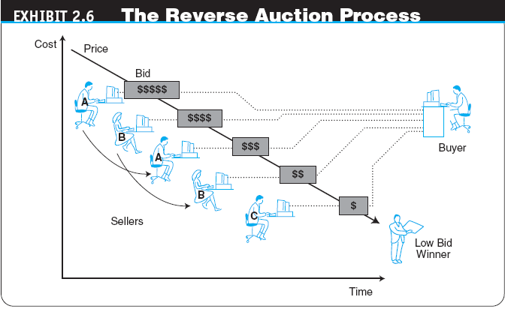

Slide 23
Auctions, Bartering, and Negotiating Online
  Many Sellers, Many Buyers
    double auction
    An auction in which multiple buyers and their bidding prices are matched with multiple sellers and their asking prices, considering the quantities on both sides
Copyright © 2009 Pearson Education, Inc. Publishing as Prentice Hall

Slide 24
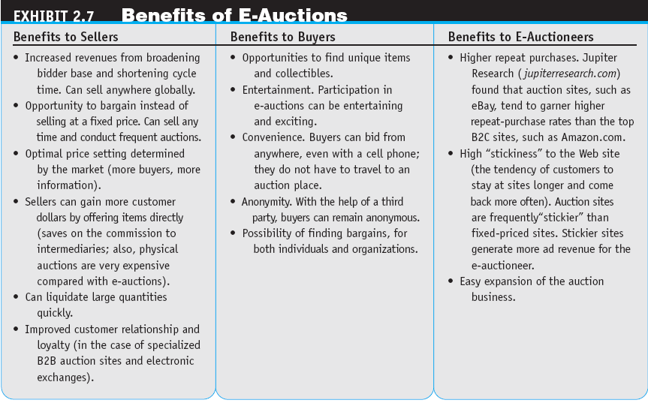

Slide 25
Auctions, Bartering, and Negotiating Online
  Limitations of E-Auctions
    Minimal Security
    Possibility of Fraud
    Limited Participation
  Impacts of Auctions
    Auctions as a Coordination Mechanism
    Auctions as a Social Mechanism to Determine a Price
    Auctions as a Highly Visible Distribution Mechanism
    Auctions as an EC Component
    Auctions for Profit for Individuals

Slide 26
Auctions, Bartering, and Negotiating Online
ONLINE BARTERING
  bartering
  The exchange of goods and services
  e-bartering (electronic bartering)
  Bartering conducted online, usually in a bartering exchange
  bartering exchange
  A marketplace in which an intermediary arranges barter transactions
ONLINE NEGOTIATING

Slide 27
Web 2.0 Tools and Services:
From Blogs to Wikis
BLOGGING (WEBLOGGING)
  blog
  A personal Web site that is open to the public to read and to interact with; dedicated to specific topics or issues
  vlog (or video blog)
  A blog with video content

Slide 28
Web 2.0 Tools and Services:
From Blogs to Wikis
  micro-blogging
  A form of blogging that allows users to write messages (usually up to 140 characters) and publish them, either to be viewed by anyone or by a restricted group that can be chosen by the user. These messages can be submitted by a variety of means, including text messaging, instant messaging, e-mail, MP3, or just on the Web

Slide 29
Web 2.0 Tools and Services:
From Blogs to Wikis
  Twitter
  A free micro-blogging service that allows its users to send and read other users’ updates.
  tweets
  Text-based posts up to 140 characters in length posted to Twitter
  Commercial Uses of Blogs
  Using Blogging to Facilitate Collaboration
  Potential Risks of Corporate Blogs
  Bloggers and Politics

Slide 30
Web 2.0 Tools and Services:
From Blogs to Wikis
Mechanism Aids for Web 2.0 Tools
  tag
  A nonhierarchical keyword or term assigned to a piece of information (such as an Internet bookmark, digital image, video clip, or any computer document)
  folksonomy (collaborative tagging, social classification, social indexing, social tagging)
  The practice and method of collaboratively creating, classifying, and managing tags to annotate and categorize content

Slide 31
Web 2.0 Tools and Services:
From Blogs to Wikis
  social bookmarking
  Web service for sharing Internet bookmarks. The sites are a popular way to store, classify, share, and search links through the practice of folksonomy techniques on the Internet and intranets
wiki (wikilog)
A blog that allows everyone to participate as a peer; anyone may add, delete, or change content

Slide 32
Virtual Worlds As an
Electronic Commerce Mechanism
avatars
Animated computer characters that exhibit humanlike movements and behaviors
BUSINESS ACTIVITIES AND VALUE IN VIRTUAL WORLDS
  Types of business activities in virtual worlds:
    Creating and managing a virtual business
    Conducting regular business activities
    Providing services for those who build, manage, or make money with virtual properties

Slide 33
Impacts of Electronic Commerce on Business Processes and Organizations
TRANSFORMING ORGANIZATIONS
  Technology and Organizational Learning
  The Changing Nature of Work
  Disintermediation and Reintermediation
    disintermediation
    Elimination of intermediaries between sellers and buyers
    reintermediation
    Disintermediated entities or newcomers take on new intermediary roles

Slide 34
Impacts of Electronic Commerce on Business Processes and Organizations
REDEFINING ORGANIZATIONS
  New and Improved Product Capabilities
  mass customization
  A method that enables manufacturers to create specific products for each customer based on the customer’s exact needs
  build-to-order (pull system)
  A manufacturing process that starts with an order (usually customized). Once the order is paid for, the vendor starts to fulfill it

Slide 35
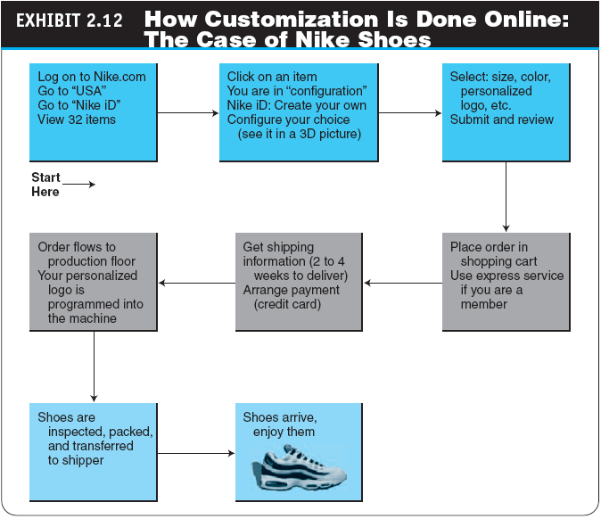

Slide 36
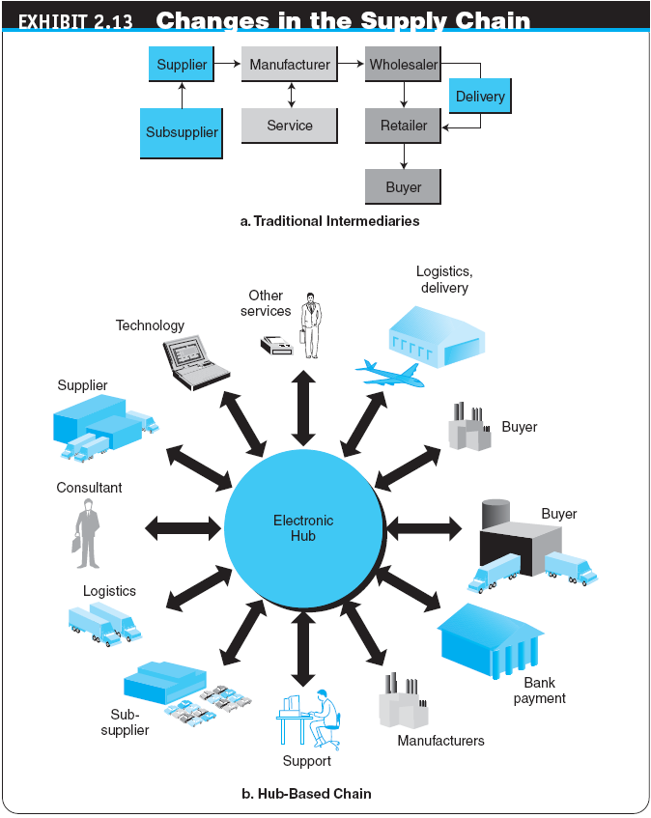

Slide 37
Managerial Issues
What about intermediaries?
Should we auction?
Should we barter?
How do we compete in the digital economy?
What organizational changes will be needed?

