Slide 1
Chapter 07a
Electronic Commerce Payment Systems

Slide 2
Learning Objectives
Understand the shifts that are occurring with regard to online payments.
Discuss the players and processes involved in using credit cards online.
Discuss the different categories and potential uses of smart cards.
Discuss various online alternatives to credit card payments and identify under what circumstances they are best used.
Describe the processes and parties involved in e-checking.
Describe payment methods in B2B EC, including payments for global trade.

Slide 3
The Payment Revolution
Today, we are in the midst of a worldwide payment revolution, with cards and electronic payments taking the place of cash and checks
A number of factors come into play in determining whether a particular method of e-payment achieves critical mass

Slide 4
The Payment Revolution
  Independence
  Interoperability and Portability
  Security
  Anonymity
  Divisibility
  Ease of Use
  Transaction Fees
  International Support
  Regulations

Slide 5
Using Payment Cards Online
payment card
Electronic card that contains information that can be used for payment purposes
Three forms of payment cards:
  Credit cards
  Charge cards
  Debit cards

Slide 6
Using Payment Cards Online
PROCESSING CARDS ONLINE
  authorization
  Determines whether a buyer’s card is active and whether the customer has sufficient funds
  settlement
  Transferring money from the buyer’s to the merchant’s account

Slide 7
Using Payment Cards Online
  There are three basic configurations for processing online payments used by merchants:
    Own the payment software
    Use a point of sale system (POS) operated by an acquirer
    Use a POS operated by a payment service provider
      payment service provider (PSP)
      A third-party service connecting a merchant’s EC system to the appropriate acquiring bank or financial institution. PSPs must be registered with the various card associations they support

Slide 8
Using Payment Cards Online
The key participants in processing card payments online include the following:
  Acquiring bank
  Credit card association
  Customer
  Issuing bank
  Merchant
  Payment processing service
  Processor

Slide 9
Using Payment Cards Online
FRAUDULENT CARD TRANSACTIONS
  The key tools used in combating fraud:
    Address Verification System (AVS)
    Detects fraud by comparing the address entered on a Web page with the address information on file with the cardholder’s issuing bank
    card verification number (CVN)
    Detects fraud by comparing the verification number printed on the signature strip on the back of the card with the information on file with the cardholder’s issuing bank
    Negative lists

Slide 10
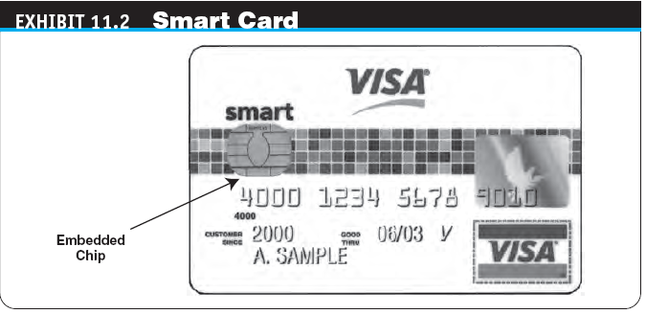
Smart Cards
smart card
An electronic card containing an embedded microchip that enables predefined operations or the addition, deletion, or manipulation of information on the card

Slide 11
Smart Cards
TYPES OF SMART CARDS
  contact card
  A smart card containing a small gold plate on the face that when inserted in a smart card reader makes contact and passes data to and from the embedded microchip
  contactless (proximity) card
  A smart card with an embedded antenna, by means of which data and applications are passed to and from a card reader unit or other device without contact between the card and the card reader

Slide 12
Smart Cards
  smart card reader
  Activates and reads the contents of the chip on a smart card, usually passing the information on to a host system
  smart card operating system
  Special system that handles file management, security, input/output (I/O), and command execution, and provides an application programming interface (API) for a smart card

Slide 13
Smart Cards
APPLICATIONS OF SMART CARDS
  Retail Purchases
  Transit Fares

Slide 14
Stored-Value Cards
stored-value card
A card that has monetary value loaded onto it and that is usually rechargeable

Slide 15
E-Micropayments
e-micropayments
Small online payments, typically under $10
  Five basic micropayment models that do not depend solely or directly on credit or debit cards:
    Aggregation
    Direct payment
    Stored value
    Subscriptions
    À la carte

Slide 16
E-Checking
e-check(past year quest nov 2008)
A legally valid electronic version or representation of a paper check
  Automated Clearing House (ACH) Network
  A nationwide batch-oriented electronic funds transfer system that provides for the interbank clearing of electronic payments for participating financial institutions

Slide 17
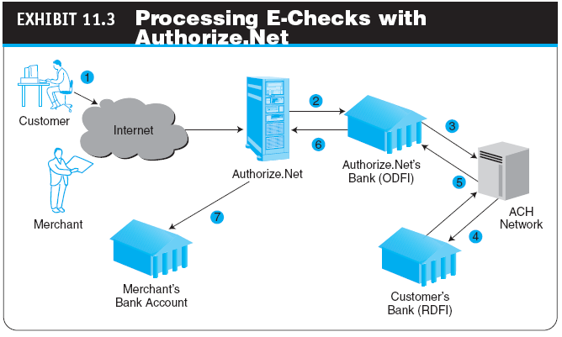

Slide 18
B2B Electronic Payments
CURRENT B2B PAYMENT PRACTICES
  The goal of financial supply chain management is to optimize:
    Accounts payable (A/P)
    Accounts receivable (A/R)
    Cash management
    Working capital
    Transaction costs
    Financial risks
    Financial administration

Slide 19
B2B Electronic Payments
enterprise invoice presentment and payment (EIPP)
Presenting and paying B2B invoices online
  EIPP Models
    Seller Direct
    Buyer Direct
    Consolidator

Slide 20
B2B Electronic Payments
  EIPP Options
    ACH Network
    purchasing cards (p-cards)
    Special-purpose payment cards issued to a company’s employees to be used solely for purchasing nonstrategic materials and services up to a preset dollar limit
    Fedwire or Wire Transfer
    letter of credit (L/C)
    A written agreement by a bank to pay the seller, on account of the buyer, a sum of money upon presentation of certain documents

Slide 21
Managerial Issues
What payment methods should your B2C site support?
What e-micropayment strategy should your e-marketplace support?
What payment methods should B2B exchanges support?
What payment methods should a C2C marketplace support?
Should we outsource our payment gateway service?
How secure are e-payments?
What is the required security to use Internet banking?

