Slide 1
Chapter 7b
Fulfilling E-commerce Orders
and Other EC Support Services

Slide 2
Learning Objectives
Describe the role of support services in electronic commerce (EC).
Define EC order fulfillment and describe the EC order fulfillment process.
Describe the major problems of EC order fulfillment.
Describe various solutions to EC order fulfillment problems.

Slide 3
Learning Objectives
Describe the integration of enterprise systems and e-commerce.
Describe enterprise resource planning (ERP) and its benefits.
Describe intelligent agents as supporters of EC.
Describe other EC support services.
Discuss the drivers of outsourcing support services.

Slide 4
Order Fulfillment and Logistics—
An Overview
ACQUIRING GOODS AND SERVICES
  Sellers need to acquire what they sell.
  They produce it if they are manufacturers.
  They buy it if they are retailers.
  They just refer buyers to sellers if they are intermediaries.

Slide 5
Order Fulfillment and Logistics—
An Overview
BASIC CONCEPTS OF ORDER FULFILLMENT AND LOGISTICS
  order fulfillment
  All the activities needed to provide customers with their ordered goods and services, including related customer services
  back-office operations
  The activities that support fulfillment of orders, such as packing, delivery, accounting, and logistics
  front-office operations
  The business processes, such as sales and advertising, which are visible to customers

Slide 6
Order Fulfillment and Logistics—
An Overview
logistics
The operations involved in the efficient and effective flow and storage of goods, services, and related information from point of origin to point of consumption
  e-logistics
  The logistics of EC systems, typically involving small parcels sent to many customers’ homes (in B2C)

Slide 7
How e-logistic differs from Traditional method
Characteristic | Traditional knowledge | EC Logistic
Type quantity Destinations Value of shipment Warehouse Nature of demand | Bulk, large volume Few Large more than $1000 Common stable | Small, parcels Large number Less than $50 Only larger shippers seasonal

Slide 8
Order Fulfillment and Logistics—
An Overview
THE EC ORDER FULFILLMENT PROCESS
  Activity 1: Making sure the customer will pay
  Activity 2: Checking for in-stock availability
  Activity 3: Arranging shipments
  Activity 4: Insurance
  Activity 5: Replenishment
  Activity 6: In-house production
  Activity 7: Use contractors
  Activity 8: Contacts with customers
  Activity 9: Returns
    reverse logistics
    The movement of returns from customers to vendors

Slide 9
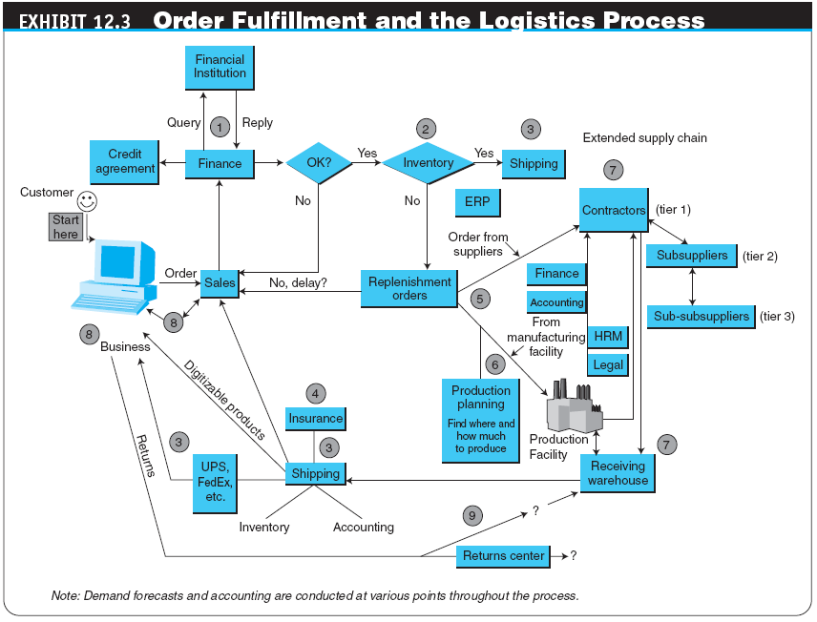

Slide 10
Order Fulfillment and Logistics—
An Overview
  The Administrative Activities of Order Taking and Fulfillment
Product inquiry
Sales quote
Order configuration
Order booking
Order acknowledgment/confirmation
Order sourcing or planning
Order changes
Shipment release
Shipment
Delivery
Settlement
Returns

Slide 11
Problems in Order Fulfillment
TYPICAL SUPPLY CHAIN PROBLEMS
WHY SUPPLY CHAIN PROBLEMS EXIST
  third-party logistics suppliers (3PL)
  External, rather than in-house, providers of logistics services

Slide 12
Solutions to
Order Fulfillment Problems
IMPROVEMENTS IN THE ORDER-TAKING ACTIVITY
warehouse management system (WMS)
A software system that helps in managing warehouses
  Other Inventory Management Improvements
  Automated Warehouses
  Using Wireless Technologies

Slide 13
Solutions to
Order Fulfillment Problems
SPEEDING DELIVERIES
  Same-Day, Even Same-Hour, Delivery
  Supermarket Deliveries
  A Speedier Superstore Using a Drive-In Model
  Failed Delivery Companies

Slide 14
Solutions to
Order Fulfillment Problems
PARTNERING EFFORTS AND OUTSOURCING LOGISTICS
  Comprehensive Logistics Services
  Outsourcing Logistics
INTEGRATED GLOBAL LOGISTICS SYSTEMS
  Fulfilling Orders
    Intelligent Factories
    Distributed Mass Customization

Slide 15
Solutions to
Order Fulfillment Problems
HANDLING RETURNS (REVERSE LOGISTICS)
  Return the item to the place of purchase
  Separate the logistics of returns from the logistics of delivery
  Completely outsource returns
  Allow the customer to physically drop the returned item at a collection station
  Auction the returned items

Slide 16
Solutions to
Order Fulfillment Problems
ORDER FULFILLMENT IN B2B
  Using BPM to Improve Order Fulfillment
  Using E-Marketplaces and Exchanges to Ease Order Fulfillment Problems in B2B
  Order Fulfillment in Services

Slide 17
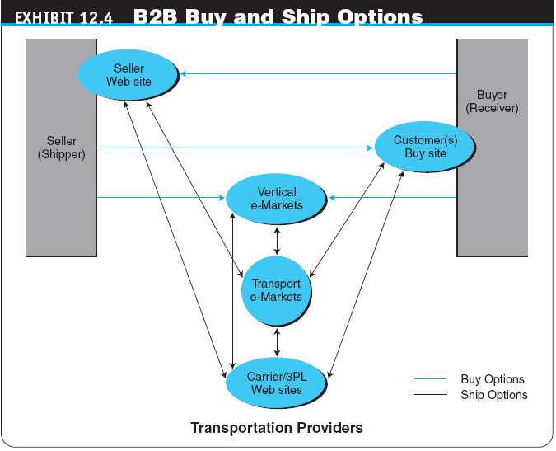

Slide 18
Solutions to
Order Fulfillment Problems
INNOVATIVE E-FULFILLMENT STRATEGIES
  merge-in-transit
  Logistics model in which components for a product may come from two (or more) different physical locations and are shipped directly to the customer’s location
  rolling warehouse
  Logistics method in which products on the delivery truck are not preassigned to a destination, but the decision about the quantity to unload at each destination is made at the time of unloading

Slide 19
Integration and
Enterprise Resource Planning
enterprise resource planning (ERP)
An enterprisewide information system designed to coordinate all the resources, information, and activities needed to complete business processes such as order fulfillment or billing
  ERP’s Structure
  Objectives and Vendors

Slide 20
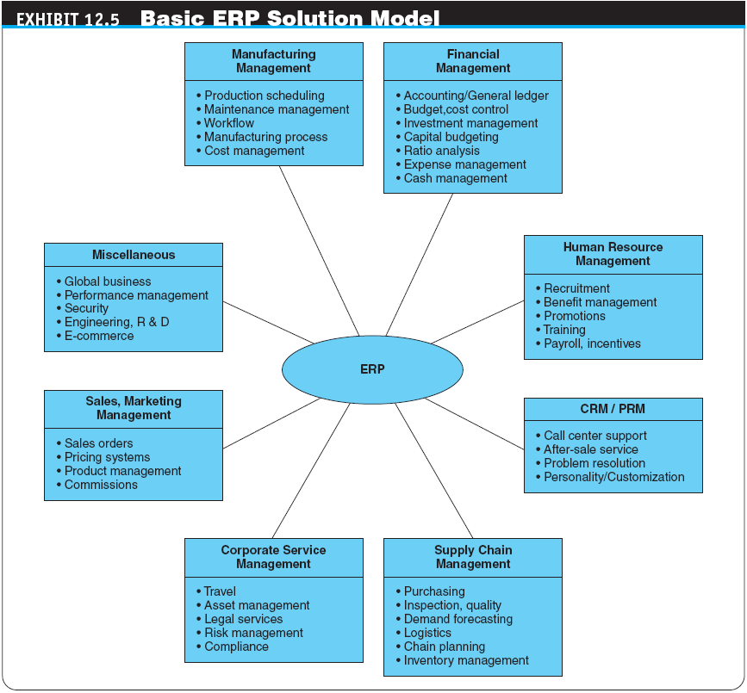

Slide 21
Integration and
Enterprise Resource Planning
ADVANTAGES AND BENEFITS OF ERP SYSTEMS
  Major potential benefits of ERP systems:
    Buyers can reach more vendors
    Potential for substantial yearly savings to buyers from cost reduction
    Faster product/service look-up and ordering
    Automated ordering and payment
    Fast access to detailed account histories
    Ability to distribute, receive, and award contracts out for bid much faster
    Link the budget system
    Provide easy access to trend data
    Empower departments to more closely measure program performance and results

Slide 22
Intelligent Agents and
Their Role in E-Commerce
intelligent agent (IA)
An autonomous entity that perceives its environment via sensors, and acts upon that environment directing its activity toward achieving a goal(s) (i.e., acting rationally) using its actuators

Slide 23
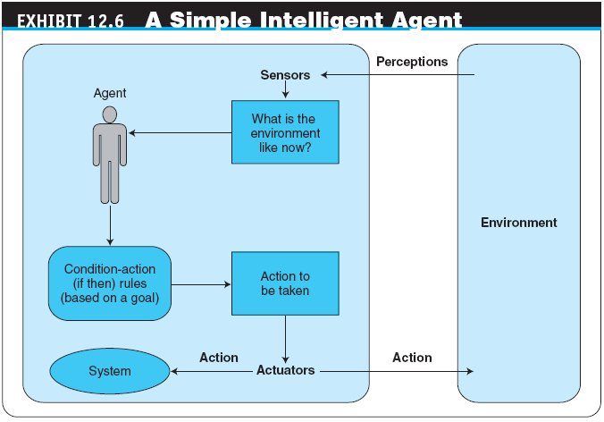

Slide 24
Intelligent Agents and
Their Role in E-Commerce
  Types of Agents
  software agents
  Autonomous software programs that carry out tasks on behalf of users
    Major types of software agents
      Simple reflex agents
      Model-based reflex agents
      Goal-based agents
      Utility-based agents

Slide 25
Intelligent Agents and
Their Role in E-Commerce
  Mobile Agents
    resident agents
    Software agents that stay in the computer or system and perform their tasks
    mobile agents
    Software agents that move to other systems, performing tasks there. A mobile agent can transport itself across different system architectures and platforms
    mobility
    The degree to which the agents themselves travel over the network. Some agents are very mobile; others are not

Slide 26
Intelligent Agents and
Their Role in E-Commerce
  learning agents
  Software agents that have the capacity to adapt or modify their behavior—that is, to learn
    A learning agent can modify its behavior in four ways:
      “Look over the shoulder” of the user
      Provide direct and indirect user feedback
      Learn from examples given by the user
      Ask the agents of other users

Slide 27
Intelligent Agents and
Their Role in E-Commerce
multiagent systems (MASs)
Computer systems in which there is no single designer who stands behind all the agents; each agent in the system can be working toward different, even contradictory, goals

Slide 28
Intelligent Agents and
Their Role in E-Commerce
APPLICATIONS OF SOFTWARE AND INTELLIGENT AGENTS IN E-COMMERCE
  Mundane personal activity
  Search and retrieval
  Repetitive office activity
  Decision support
  Domain experts
  Data mining
  Web and text mining

Slide 29
Other E-Commerce Support Services
CONSULTING SERVICES
  Online Consulting
DIRECTORY SERVICES, NEWSLETTERS, AND SEARCH ENGINES

Slide 30
Other E-Commerce Support Services
MORE EC SUPPORT SERVICES
Trust Services
Trademark and Domain Names
Digital Photos
Global Business Communities
Access to Commercial Databases
Knowledge Management
Client Matching
E-Business Rating Sites
Security and Encryption Sites
Web Research Services
Coupon-Generating Sites

Slide 31
Other E-Commerce Support Services
OUTSOURCING EC SUPPORT SERVICES
  Why Outsource EC Services?
  IT Outsourcing and Application Service Providers
    application service provider (ASP)
    An agent or vendor who assembles the functions needed by enterprises and packages them with outsourced development, operation, maintenance, and other services

Slide 32
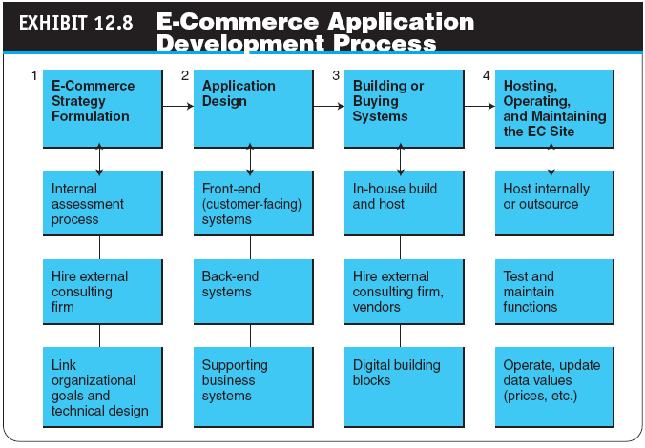

Slide 33
Managerial Issues
If you are an EC vendor, what is the bottleneck in the order fulfillment process?
For which items should we keep our own inventory?
What is the alliance strategy in order fulfillment?
How should we manage returns?

Slide 34
Managerial Issues
What logistic information should we provide to customers?
What integration policy of EC with ERP, SCM, and CRM should be in place?
Can we use intelligent agents?
Should we use RFID for the order fulfillment?

