Slide 1
Chapter 8b Law ethics and Cyber Crime
E-Commerce Cyber crime and security

Slide 2
Learning Objectives
Understand the importance and scope of security of information systems for EC.
Describe the major concepts and terminology of EC security.
Learn about the major EC security threats, vulnerabilities, and risks.
Understand phishing and its relationship to financial crimes.
Describe the information assurance security principles.
Identify and assess major technologies and methods for securing EC communications.

Slide 3
Learning Objectives
Describe the major technologies for protection of EC networks.
Describe various types of controls and special defense mechanisms.
Describe the role of business continuity and disaster recovery planning.
Discuss EC security enterprisewide implementation issues.
Understand why it is not possible to stop computer crimes.

Slide 4
The Information Security Problem
WHAT IS EC SECURITY?
  Computer security refers to the protection of data, networks, computer programs, computer power and other elements of computerized information systems
  CSI Computer Crime and Security Survey
  Annual security survey of U.S. corporations, government agencies, financial and medical institutions, and universities conducted jointly by the FBI and the Computer Security Institute

Slide 5
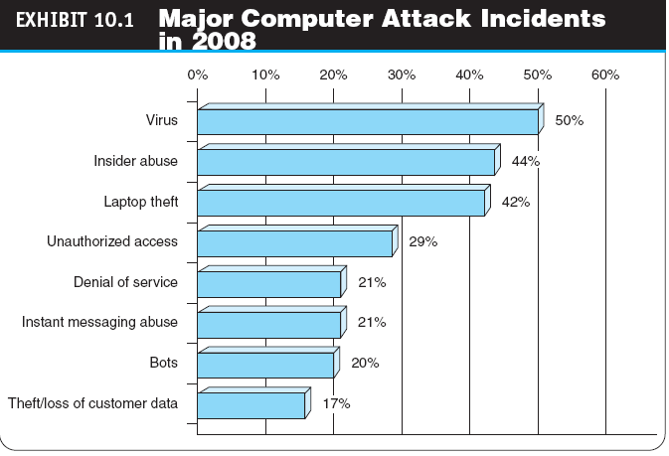

Slide 6
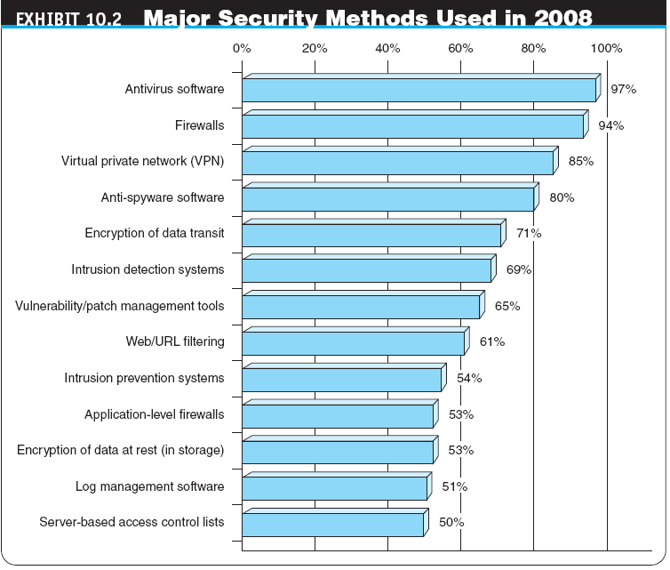

Slide 7
The Information Security Problem
THE DRIVERS OF EC SECURITY PROBLEMS
  The Internet’s Vulnerable Design
    domain name system (DNS)
    Translates (converts) domain names to their numeric IP addresses
    IP address
    An address that uniquely identifies each computer connected to a network or the Internet

Slide 8
The Information Security Problem
  The Shift to Profit-Induced Crimes
  Internet underground economy
  E-markets for stolen information made up of thousands of Web sites that sell credit card numbers, social security numbers, other data such as numbers of bank accounts, social network IDs, passwords, and much more
    keystroke logging (keylogging)
    A method of capturing and recording user keystrokes

Slide 9
Basic E-Commerce
Security Issues and Landscape
BASIC SECURITY TERMINOLOGY
  business continuity plan
  A plan that keeps the business running after a disaster occurs. Each function in the business should have a valid recovery capability plan
  cybercrime
  Intentional crimes carried out on the Internet
  exposure
  The estimated cost, loss, or damage that can result if a threat exploits a vulnerability
  fraud
  Any business activity that uses deceitful practices or devices to deprive another of property or other rights

Slide 10
Basic E-Commerce
Security Issues and Landscape
  malware (malicious software)
  A generic term for malicious software
  phishing
  A crimeware technique to steal the identity of a target company to get the identities of its customers
  risk
  The probability that a vulnerability will be known and used
  social engineering
  A type of nontechnical attack that uses some ruse to trick users into revealing information or performing an action that compromises a computer or network

Slide 11
Basic E-Commerce
Security Issues and Landscape
  spam
  The electronic equivalent of junk mail
  vulnerability
  Weakness in software or other mechanism that threatens the confidentiality, integrity, or availability of an asset (recall the CIA model). It can be directly used by a hacker to gain access to a system or network
  zombies
  Computers infected with malware that are under the control of a spammer, hacker, or other criminal

Slide 12
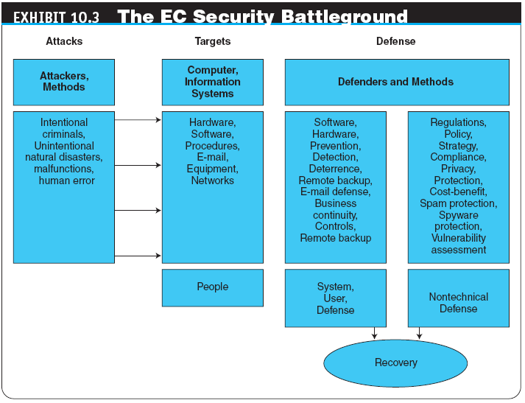

Slide 13
Basic E-Commerce
Security Issues and Landscape
SECURITY SCENARIOS AND REQUIREMENTS IN
E-COMMERCE
  EC Security Requirements
    authentication
    Process to verify (assure) the real identity of an individual, computer, computer program, or EC Web site
    authorization
    Process of determining what the authenticated entity is allowed to access and what operations it is allowed to perform
    nonrepudiation
    Assurance that online customers or trading partners cannot falsely deny (repudiate) their purchase or transaction

Slide 14
Basic E-Commerce
Security Issues and Landscape
THE DEFENSE: DEFENDERS AND THEIR STRATEGY
  EC security strategy
  A strategy that views EC security as the process of preventing and detecting unauthorized use of the organization’s brand, identity, Web site, e-mail, information, or other asset and attempts to defraud the organization, its customers, and employees

Slide 15
Basic E-Commerce
Security Issues and Landscape
  deterring measures
  Actions that will make criminals abandon their idea of attacking a specific system (e.g., the possibility of losing a job for insiders)
  prevention measures
  Ways to help stop unauthorized users (also known as “intruders”) from accessing any part of the EC system
  detection measures
  Ways to determine whether intruders attempted to break into the EC system; whether they were successful; and what they may have done

Slide 16
Basic E-Commerce
Security Issues and Landscape
  information assurance (IA)
  The protection of information systems against unauthorized access to or modification of information whether in storage, processing, or transit, and against the denial of service to authorized users, including those measures necessary to detect, document, and counter such threats

Slide 17
Technical Attack Methods
virus
A piece of software code that inserts itself into a host, including the operating systems, in order to propagate; it requires that its host program be run to activate it
worm
A software program that runs independently, consuming the resources of its host in order to maintain itself, and that is capable of propagating a complete working version of itself onto another machine
macro virus (macroworm)
A macro virus or macro worm is executed when the application object that contains the macro is opened or a particular procedure is executed

Slide 18
Technical Attack Methods
  Trojan horse
  A program that appears to have a useful function but that contains a hidden function that presents a security risk
  banking Trojan
  A Trojan that comes to life when computer owners visit one of a number of online banking or e-commerce sites

Slide 19
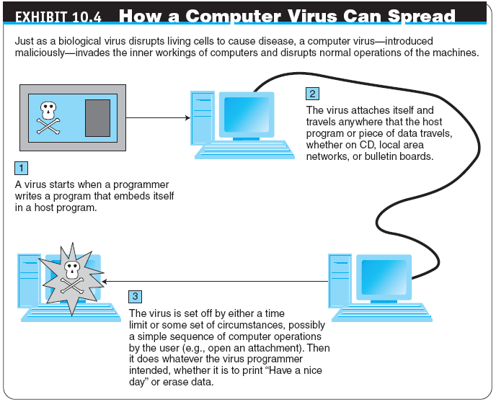

Slide 20
Technical Attack Methods
  denial of service (DOS) attack
  An attack on a Web site in which an attacker uses specialized software to send a flood of data packets to the target computer with the aim of overloading its resources
  botnet
  A huge number (e.g., hundreds of thousands) of hijacked Internet computers that have been set up to forward traffic, including spam and viruses, to other computers on the Internet

Slide 21
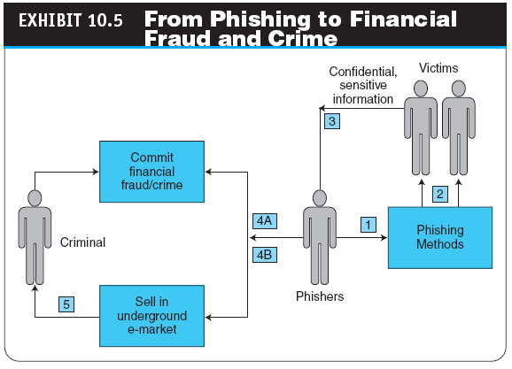

Slide 22
Phishing, Financial Fraud, and Spam
PHISHING
  universal man-in-the-middle phishing kit
  A tool used by phishers to set up a URL that can interact in real time with the content of a legitimate Web site, such as a bank or EC site, to intercept data entered by customers at log-in or check out Web pages

Slide 23
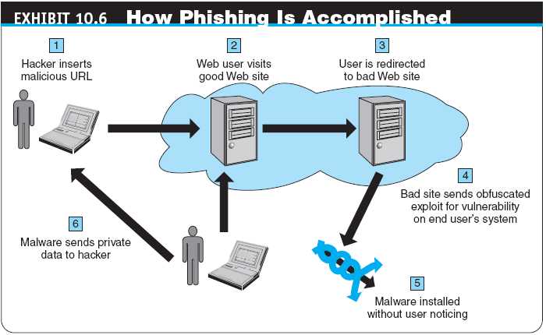

Slide 24
Phishing, Financial Fraud, and Spam
FRAUD ON THE INTERNET
  click fraud
  Type of fraud that occurs in pay-per-click advertising when a person, automated system, or computer program simulates individual clicks on banner or other online advertising methods
  identity theft
  Fraud that involves stealing an identity of a person and then the use of that identity by someone pretending to be someone else in order to steal money or get other benefits

Slide 25
Phishing, Financial Fraud, and Spam
  e-mail spam
  A subset of spam that involves nearly identical messages sent to numerous recipients by e-mail
  search engine spam
  Pages created deliberately to trick the search engine into offering inappropriate, redundant, or poor quality search results
  spam site
  Page that uses techniques that deliberately subvert a search engine’s algorithms to artificially inflate the page’s rankings
  splog
  Short for spam blog. A site created solely for marketing purposes
  spyware
  Software that gathers user information over an Internet connection without the user’s knowledge

Slide 26
The Information Assurance Model and Defense Strategy
CIA security triad (CIA triad)
Three security concepts important to information on the Internet: confidentiality, integrity, and availability
confidentiality
Assurance of data privacy and accuracy. Keeping private or sensitive information from being disclosed to unauthorized individuals, entities, or processes

Slide 27
The Information Assurance Model and Defense Strategy
integrity
Assurance that stored data has not been modified without authorization; a message that was sent is the same message that was received
availability
Assurance that access to data, the Web site, or other EC data service is timely, available, reliable, and restricted to unauthorized users

Slide 28
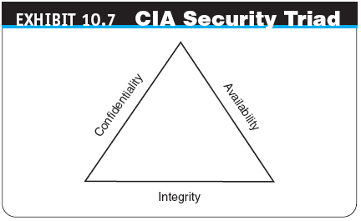

Slide 29
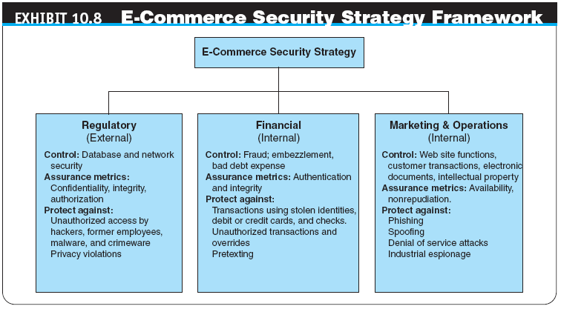

Slide 30
The Information Assurance Model and Defense Strategy
THE DEFENSE STRATEGY
  Prevention and deterrence
  Detection
  Containment
  Recovery
  Correction
  Awareness and compliance
EC security programs
All the policies, procedures, documents, standards, hardware, software, training, and personnel that work together to protect information, the ability to conduct business, and other assets

Slide 31
The Defense I:
Access Control, Encryption, and PKI
access control
Mechanism that determines who can legitimately use a network resource
  passive token
  Storage device (e.g., magnetic strip) that contains a secret code used in a two-factor authentication system
  active token
  Small, stand-alone electronic device that generates one-time passwords used in a two-factor authentication system

Slide 32
The Defense I:
Access Control, Encryption, and PKI
  biometric control
  An automated method for verifying the identity of a person based on physical or behavioral characteristics
  biometric systems
  Authentication systems that identify a person by measurement of a biological characteristic, such as fingerprints, iris (eye) patterns, facial features, or voice

Slide 33
The Defense I:
Access Control, Encryption, and PKI
ENCRYPTION AND THE ONE-KEY (SYMMETRIC) SYSTEM
  encryption
  The process of scrambling (encrypting) a message in such a way that it is difficult, expensive, or time-consuming for an unauthorized person to unscramble (decrypt) it
  symmetric (private) key encryption
  An encryption system that uses the same key to encrypt and decrypt the message

Slide 34
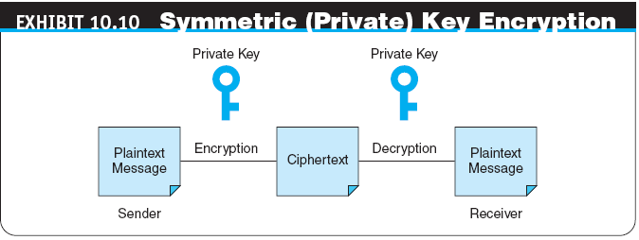

Slide 35
The Defense I:
Access Control, Encryption, and PKI
public key infrastructure (PKI)
A scheme for securing e-payments using public key encryption and various technical components
  public (asymmetric) key encryption
  Method of encryption that uses a pair of matched keys—a public key to encrypt a message and a private key to decrypt it, or vice versa
  public key
  Encryption code that is publicly available to anyone
  private key
  Encryption code that is known only to its owner

Slide 36
The Defense I:
Access Control, Encryption, and PKI
digital signature or digital certificate
Validates the sender and time stamp of a transaction so it cannot be later claimed that the transaction was unauthorized or invalid
  hash
  A mathematical computation that is applied to a message, using a private key, to encrypt the message.
  message digest (MD)
  A summary of a message, converted into a string of digits after the hash has been applied

Slide 37
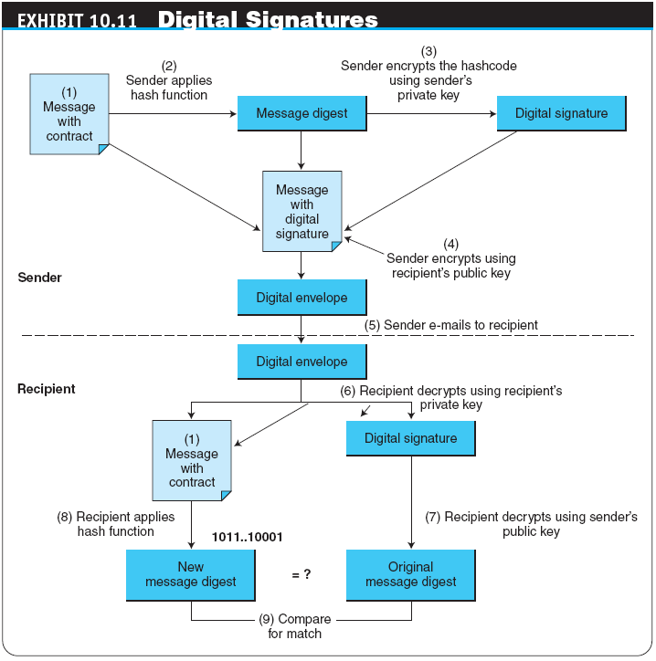

Slide 38
The Defense I:
Access Control, Encryption, and PKI
  digital envelope
  The combination of the encrypted original message and the digital signature, using the recipient’s public key
  certificate authorities (CAs)
  Third parties that issue digital certificates
  Secure Socket Layer (SSL)
  Protocol that utilizes standard certificates for authentication and data encryption to ensure privacy or confidentiality
  Transport Layer Security (TLS)
    As of 1996, another name for the SSL protocol

Slide 39
The Defense II:
Securing E-Commerce Networks
firewall
A single point between two or more networks where all traffic must pass (choke point); the device authenticates, controls, and logs all traffic
demilitarized zone (DMZ)
Network area that sits between an organization’s internal network and an external network (Internet), providing physical isolation between the two networks that is controlled by rules enforced by a firewall

Slide 40
The Defense II:
Securing E-Commerce Networks
virtual private network (VPN)
A network that uses the public Internet to carry information but remains private by using encryption to scramble the communications, authentication to ensure that information has not been tampered with, and access control to verify the identity of anyone using the network
intrusion detection system (IDS)
A special category of software that can monitor activity across a network or on a host computer, watch for suspicious activity, and take automated action based on what it sees

Slide 41
The Defense II:
Securing E-Commerce Networks
honeynet
A network of honeypots
  honeypot
  Production system (e.g., firewalls, routers, Web servers, database servers) that looks like it does real work, but that acts as a decoy and is watched to study how network intrusions occur
penetration test (pen test)
A method of evaluating the security of a computer system or a network by simulating an attack from a malicious source, (e.g., a cracker)

Slide 42
The Defense III: General Controls and Other Defense Mechanisms
general controls
Controls established to protect the system regardless of the specific application. For example, protecting hardware and controlling access to the data center are independent of the specific application
application controls
Controls that are intended to protect specific applications

Slide 43
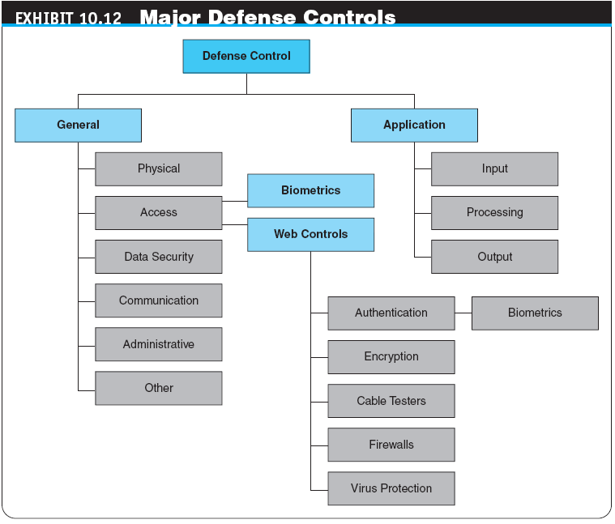

Slide 44
The Defense III: General Controls and Other Defense Mechanisms
intelligent agents
Software applications that have some degree of reactivity, autonomy, and adaptability—as is needed in unpredictable attack situations. An agent is able to adapt itself based on changes occurring in its environment

Slide 45
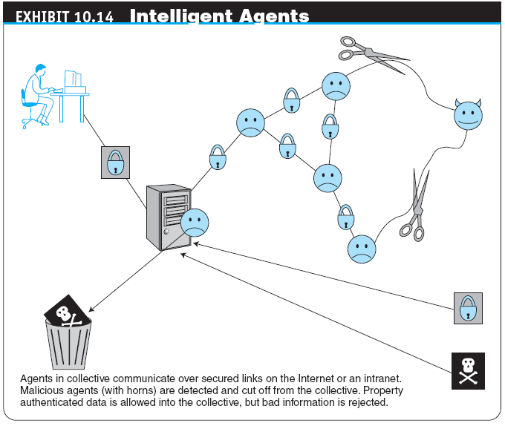

Slide 46
The Defense III: General Controls and Other Defense Mechanisms
internal control environment
The work atmosphere that a company sets for its employees
PROTECTING AGAINST SPAM
  Controlling the Assault of Non-Solicited Pornography and Marketing (CAN-SPAM) Act
  Law that makes it a crime to send commercial e-mail messages with false or misleading message headers or misleading subject lines

Slide 47
The Defense III: General Controls and Other Defense Mechanisms
  Protection Against Splogs
    Captcha tool
    Completely Automated Public Turing test to tell Computers and Humans Apart, which uses a verification test on comment pages to stop scripts from posting automatically
PROTECTING AGAINST POP-UP ADS
  Protection Against Phishing
PROTECTING AGAINST SPYWARE

Slide 48
Business Continuity,
Security Auditing, and Risk Management
BUSINESS CONTINUITY AND DISASTER RECOVERY PLANNING
  The purpose of a business continuity plan is to keep the business running after a disaster occurs
  Recovery planning is part of asset protection
  disaster avoidance
  An approach oriented toward prevention. The idea is to minimize the chance of avoidable disasters (such as fire or other human-caused threats)

Slide 49
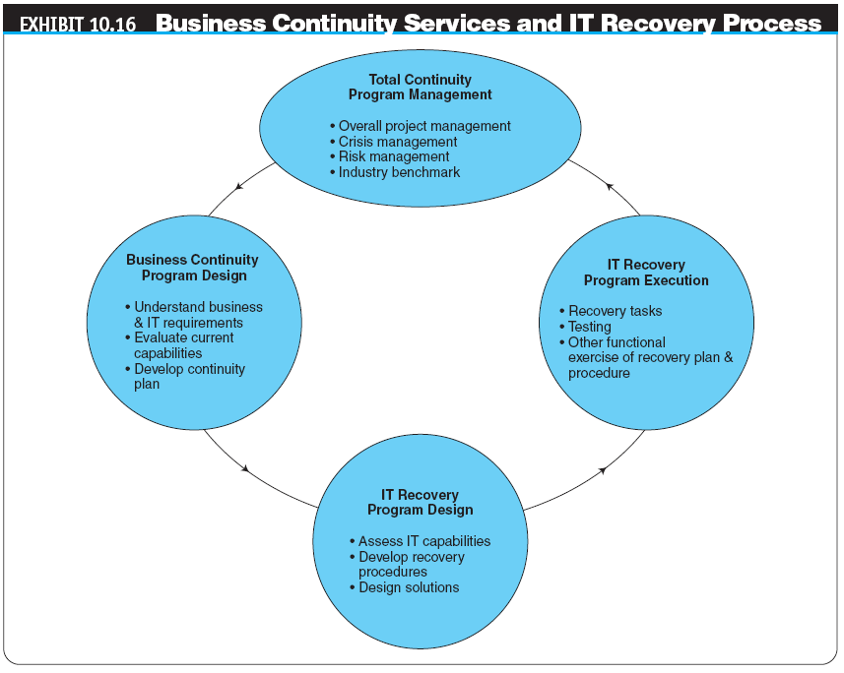

Slide 50
Business Continuity,
Security Auditing, and Risk Management
AUDITING INFORMATION SYSTEMS
  audit
  An important part of any control system. Auditing can be viewed as an additional layer of controls or safeguards. It is considered as a deterrent to criminal actions especially for insiders
RISK-MANAGEMENT AND COST–BENEFIT ANALYSIS
  Risk-Management Analysis
  Ethical Issues

Slide 51
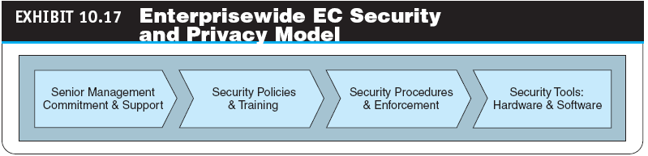
Implementing Enterprisewide
E-Commerce Security
SENIOR MANAGEMENT COMMITMENT AND SUPPORT

Slide 52
Implementing Enterprisewide
E-Commerce Security
EC SECURITY POLICIES AND TRAINING
  acceptable use policy (AUP)
  Policy that informs users of their responsibilities when using company networks, wireless devices, customer data, and so forth
EC SECURITY PROCEDURES AND ENFORCEMENT
  business impact analysis (BIA)
  An exercise that determines the impact of losing the support of an EC resource to an organization and establishes the escalation of that loss over time, identifies the minimum resources needed to recover, and prioritizes the recovery of processes and supporting systems

Slide 53
Implementing Enterprisewide
E-Commerce Security
  Ignoring EC Security Best Practices
    Computing Technology Industry Association (CompTIA)
    Nonprofit trade group providing information security research and best practices
  Lack of Due Care in Business Practices
    standard of due care
    Care that a company is reasonably expected to take based on the risks affecting its EC business and online transactions

Slide 54
Managerial Issues
Why is an EC security strategy and life-cycle approach needed?
What is the EC security strategy of your company?
Is the budget for IT security adequate?
What steps should businesses follow in establishing a security plan?
Should organizations be concerned with internal security threats?
What is the key to establishing strong e-commerce security?

