Slide 1
Chapter 9
E-Commerce Strategy and Global EC

Slide 2
Learning Objectives
Describe the strategic planning process.
Describe the purpose and content of a business plan and a business case.
Understand how e-commerce impacts the strategic planning process.
Understand how to formulate, justify, and prioritize EC applications.

Slide 3
Learning Objectives
Describe strategy implementation and assessment, including the use of metrics.
Evaluate the issues involved in global EC.
Analyze the impact of EC on small and medium-sized businesses.

Slide 4
Organizational Strategy:
Concepts and Overview
strategy
A broad-based formula for how a business is going to accomplish its mission, what its goals should be, and what plans and policies will be needed to carry out those goals

Slide 5
Organizational Strategy:
Concepts and Overview
STRATEGY AND THE WEB ENVIRONMENT
  Porter’s Competitive Forces Model and Strategies
    The five major forces in an industry that affect the degree of competition and, ultimately, the degree of profitability are:
      1. Threat of entry of new competitors
      2. Bargaining power of suppliers
      3. Bargaining power of customers or buyers
      4. Threat of substitute products or services
      5. Rivalry among existing firms in the industry

Slide 6
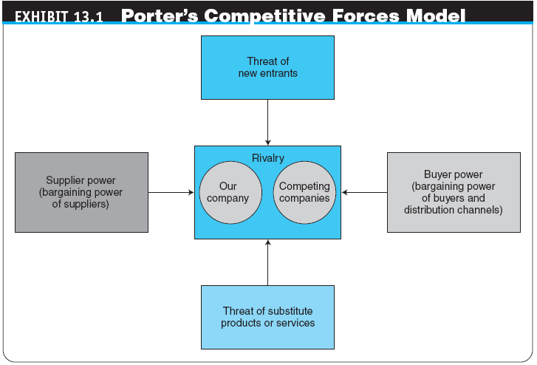

Slide 7
Organizational Strategy:
Concepts and Overview
  The Impact of the Internet
  e-commerce strategy (e-strategy)
  The formulation and execution of a vision of how a new or existing company intends to do business electronically
  Strategic Planning for IT and EC
    strategic information systems planning (SISP)
    A process for developing a strategy and plans for aligning information systems (including e-commerce applications) with the organization’s business strategies

Slide 8
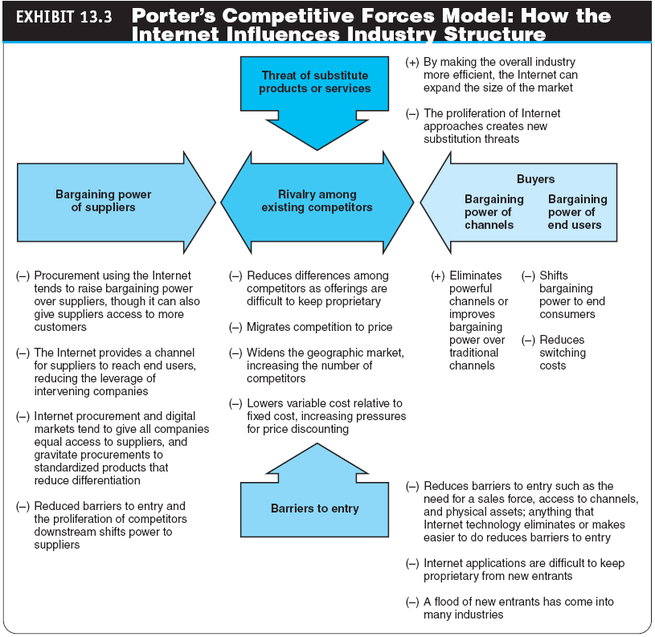

Slide 9
Organizational Strategy:
Concepts and Overview
THE STRATEGIC PLANNING PROCESS
  strategy initiation
  The initial phase of strategic planning in which the organization examines itself and its environment
    Specific outcomes from this phase include:
      Company analysis and value proposition
        value proposition
        The benefit that a company’s products or services provide to a company and its customers
      Core competencies
      Forecasts
      Competitor (industry) analysis

Slide 10
Organizational Strategy:
Concepts and Overview
  strategy formulation
  The development of strategies to exploit opportunities and manage threats in the business environment in light of corporate strengths and weaknesses
    Specific activities and outcomes from this phase include:
      Business opportunities
      Cost–benefit analysis
      Risk analysis, assessment, and management
      Business plan

Slide 11
Organizational Strategy:
Concepts and Overview
  strategy implementation
  The development of detailed, short-term plans for carrying out the projects agreed on in strategy formulation
    Specific activities and outcomes from this phase include:
      Project planning
      Resource allocation
      Project management

Slide 12
Organizational Strategy:
Concepts and Overview
  strategy assessment
  The continuous evaluation of progress toward the organization’s strategic goals, resulting in corrective action and, if necessary, strategy reformulation

Slide 13
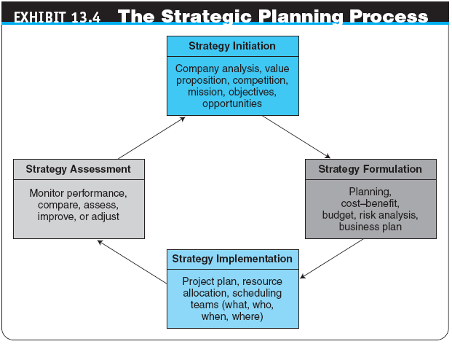

Slide 14
Organizational Strategy:
Concepts and Overview
STRATEGIC PLANNING TOOLS
  SWOT analysis
  A methodology that surveys external opportunities and threats and relates them to internal strengths and weaknesses
  competitor analysis grid
  A strategic planning tool that highlights points of differentiation between competitors and the target firm

Slide 15
Organizational Strategy:
Concepts and Overview
  scenario planning
  A strategic planning methodology that generates plausible alternative futures to help decision makers identify actions that can be taken today to ensure success in the future
  balanced scorecard (BSC)
  A management tool that assesses organizational progress toward strategic goals by measuring performance in a number of different areas

Slide 16
Business Planning in E-Commerce
business plan
A written document that identifies a company’s goals and outlines how the company intends to achieve the goals and at what cost
business case
A business plan for a new initiative or large, new project inside an existing organization

Slide 17
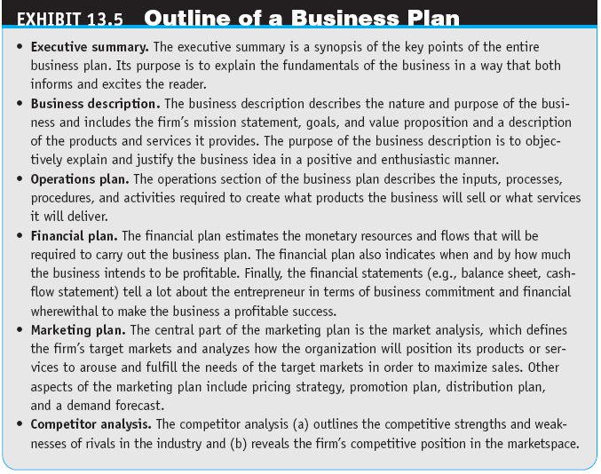

Slide 18
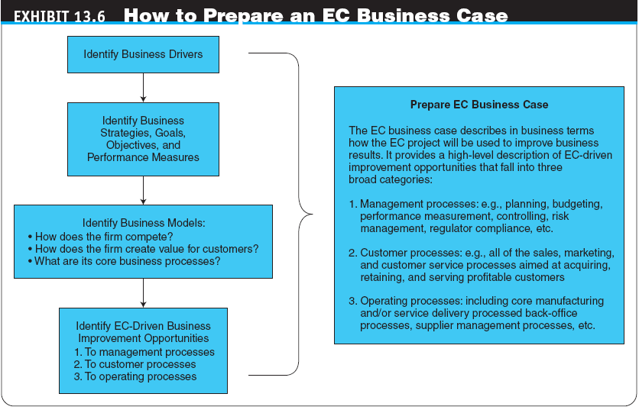

Slide 19
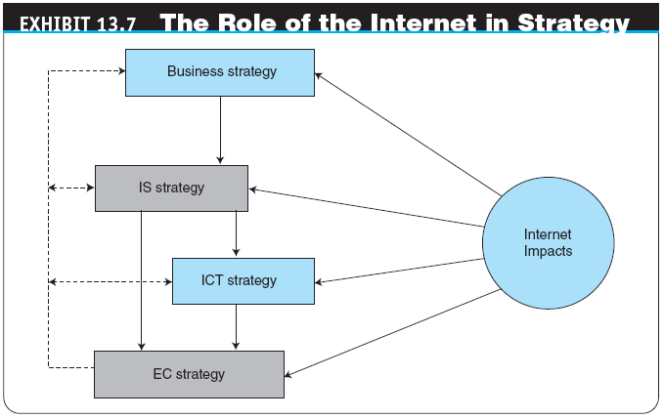

Slide 20
E-Strategy Initiation
REPRESENTATIVE ISSUES IN E-STRATEGY INITIATION
  Be a First Mover or a Follower?
  Born-on-the-Net or Move-to-the-Net?
  Determining Scope
  Have a Separate Online Company?
  Have a Separate Online Brand?
STRATEGY IN THE WEB 2.0 ENVIRONMENT AND IN SOCIAL NETWORKING

Slide 21
E-Strategy Formulation
SELECTING EC OPPORTUNITIES
DETERMINING AN APPROPRIATE EC APPLICATION PORTFOLIO MIX
  The BCG Model and an Internet Portfolio Map

Slide 22
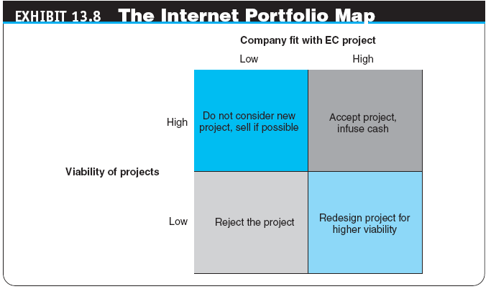

Slide 23
E-Strategy Initiation
e-commerce (EC) risk
The likelihood that a negative outcome will occur in the course of developing and operating an electronic commerce strategy
  Security Issues

Slide 24
E-Strategy Initiation
ISSUES IN STRATEGY FORMULATION
  How to Handle Channel Conflict
  How to Handle Conflict Between the Offline and Online Businesses

Slide 25
E-Strategy Initiation
Pricing Strategy
  Price comparison is easier
  Buyers sometimes set the price
  Online and offline goods are priced differently
  Differentiated pricing can be a pricing strategy
    versioning
    Selling the same good, but with different selection and delivery characteristics

Slide 26
E-Strategy Implementation
E-STRATEGY IMPLEMENTATION PROCESS
  Create a Web Team
    project champion
    The person who ensures the EC project gets the time, attention, and resources required and defends the project from detractors at all time
  Start with a Pilot Project
  Allocate Resources
  Manage the Project

Slide 27
E-Strategy Implementation
STRATEGY IMPLEMENTATION ISSUES
  Application Development
  Outsource: What? When? To Whom?
    outsourcing
    The use of an external vendor to provide all or part of the products and services that could be provided internally
  Partners’ Strategy

Slide 28
E-Strategy Implementation
  Business Alliances and Virtual Corporations
    virtual corporation (VC)
    An organization composed of several business partners sharing costs and resources for the production or utilization of a product or service
    co-opetition
    Two or more companies cooperate together on some activities for their mutual benefit, even while competing against each other in the marketplace

Slide 29
E-Strategy Implementation
  Redesigning Business Processes and BPR
    business process reengineering (BPR)
    A methodology for conducting a comprehensive redesign of an enterprise’s processes
  business process management (BPM)
  Method for business restructuring that combines workflow systems and redesign methods; covers three process categories—people-to-people, systems-to-systems, and systems-to-people interactions

Slide 30
E-Strategy and Project Assessment
THE OBJECTIVES OF ASSESSMENT
  Measure the extent to which the EC strategy and ensuing projects are delivering what they were supposed to deliver
  Determine if the EC strategy and projects are still viable in the current environment
  Reassess the initial strategy in order to learn from mistakes and improve future planning
  Identify failing projects as soon as possible and determine why they failed to avoid the same problems on subsequent projects

Slide 31
E-Strategy and Project Assessment
MEASURING RESULTS AND USING METRICS
  EC Metrics
    metric
    A specific, measurable standard against which actual performance is compared
  corporate (business) performance management (CPM, BPM)
  Advanced performance measuring and analysis approach that embraces planning and strategy

Slide 32
E-Strategy and Project Assessment
Strategic planning in CPM includes the following eight steps:
  Conduct a current situation analysis
  Determine the planning horizon
  Conduct an environment scan
  Identify critical success factors
  Complete a gap analysis (performance vs. goals)
  Create a strategic vision
  Develop a business strategy
  Identify strategic objectives and goals

Slide 33
E-Strategy and Project Assessment
  strategy map
  A tool that delineates the relationships among the key organizational objectives for all four balanced scorecard (BSC) perspectives
  Web analytics
  The analysis of clickstream data to understand visitor behavior on a Web site

Slide 34
Global E-Commerce
BENEFITS AND EXTENT OF OPERATIONS
  The ability to do business at any time, from anywhere, and at a reasonable cost
BARRIERS TO GLOBAL EC
  Cultural Issues
  Culture and Language Translation
  Administrative Issues
  Geographic Issues and Localization
  Economic Issues

Slide 35
Global E-Commerce
BREAKING DOWN THE BARRIERS TO GLOBAL EC
  Be strategic
  Know your audience
  Localize
  Think globally, act consistently
  Value the human touch
  Clarify, document, explain
  Offer services that reduce barriers

Slide 36
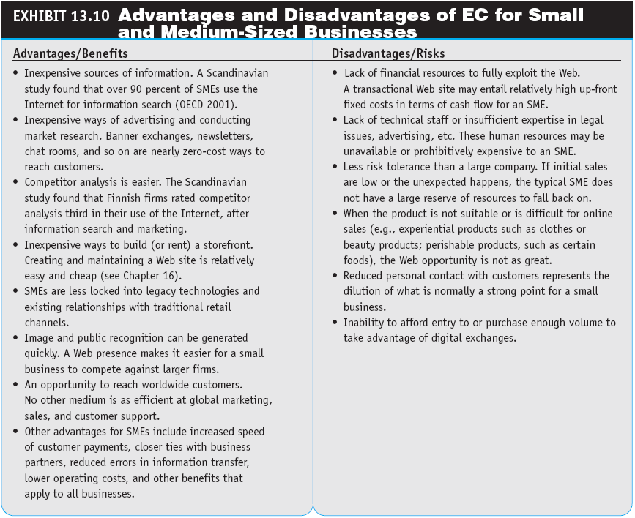

Slide 37
Managerial Issues
What is the strategic value of EC to the organization?
What is the scope of e-business planning?
How to relate the EC activities with business objectives and metrics?
Should the dot-com activities be spun off as a separate company?

Slide 38
Managerial Issues
How should the e-business scope evolve?
What are the benefits and risks of EC?
Why do we need an EC planning process?
How can EC go global?
How to manage the EC project?

